Slide 1
Docking

Slide 2
Structure-Based Design - Docking
A General Workflow

Slide 3
Copyright and Disclaimer
Copyright © 2013 Accelrys Software Inc. All rights reserved.
This product (software and/or documentation) is furnished under a License/Service Agreement and may be used only in accordance with the terms of such agreement.
Acknowledgments and References
Accelrys may grant permission to republish or reprint its copyrighted materials. Requests should be submitted to Accelrys Scientific and Technical Support, either through email to support@accelrys.com or in writing to:
    Accelrys Support
    5005 Wateridge Vista Drive,
    San Diego, CA 92121,
    USA
This presentation may contain information on the roadmap and future software development efforts and is intended to outline our general product direction. It should not be relied on in making a purchasing decision.
In addition, information disclosed in this presentation and related documents, whether oral or written, is confidential or proprietary information of Accelrys. It shall be used only for the purpose of furthering our business relationship, and shall not be disclosed to third parties.

Slide 4
Overview
Preparation for structure-based design - docking
Docking methods
Scoring of docking results
Analysis, refinement and filtering tools
More detailed documentation on the theory, algorithms, protocol parameters and tutorials described in this training can be found in Discovery Studio under the Help command menu or F1 (context sensitive help throughout the client)

Slide 5
Docking Workflow
Preparation
Protein & Ligands
All projects require an initial validation phase of this docking workflow to maximize the probability of success
Without some validation there is no way to discriminate or prioritize ligands and no yardstick with which measure the success of a ‘blind’ screening
Docking
Validation
Requirements
Known actives and decoys
Native docked ligand (optional)
Objectives
Optimize parameters for docking method
Identify scoring function(s) which best discriminate/ prioritize actives and decoys
Identify molecular interactions which may help discriminate actives and decoys
Scoring
Screening
Filtering
Refinement
Analysis
Some tools for scoring, prioritization, refinement, filtering, and analysis are specific for the validation phase of a docking project
Other tools can also be used during the validation or screening phases

Slide 6
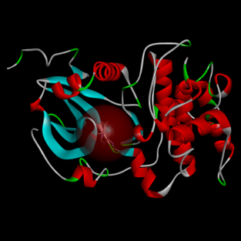
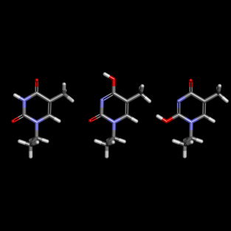
Preparation of Input Structures
Preparation
Protein & Ligands
Protein Preparation
Protein Preparation
Required for correct representation of active site residues
Can rectify problems with experimental structures
Includes tools to identify binding sites
Docking
Scoring
Ligand Preparation
Ligand Preparation
Required for correct representation of ligand chemistry in vivo
Options:
  Add hydrogens
  Calculate 3D coordinates
  Enumerate ionization states
  Ionize functional groups
  Generate tautomers and isomers
  Remove duplicates
  Fix bad valencies
  Standardize charges for common groups
  Retain largest fragment
Filtering
Refinement
Analysis

Slide 7
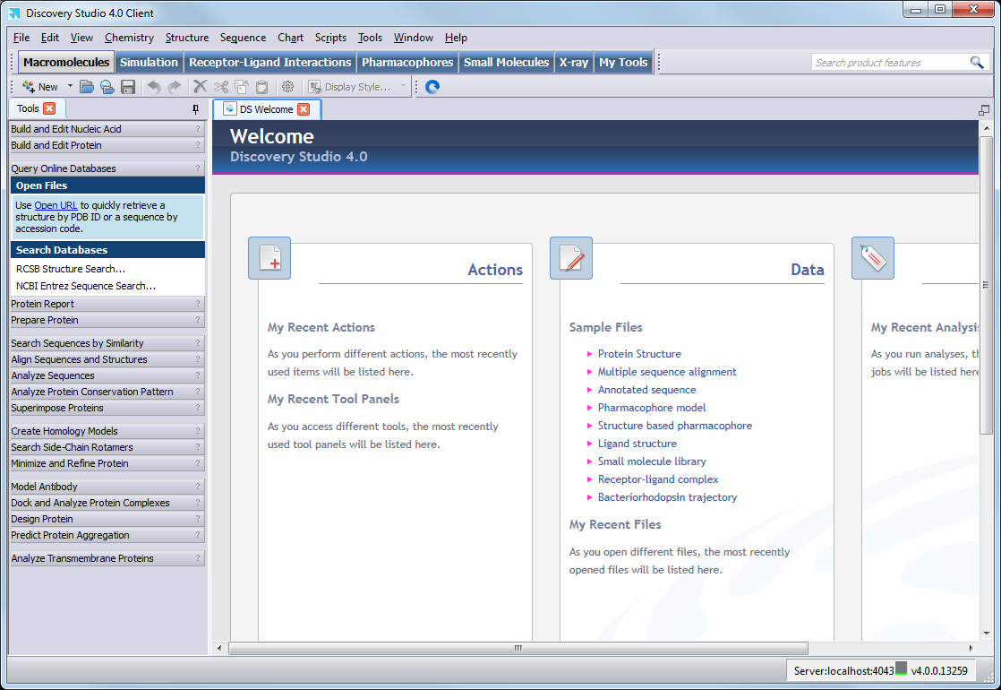
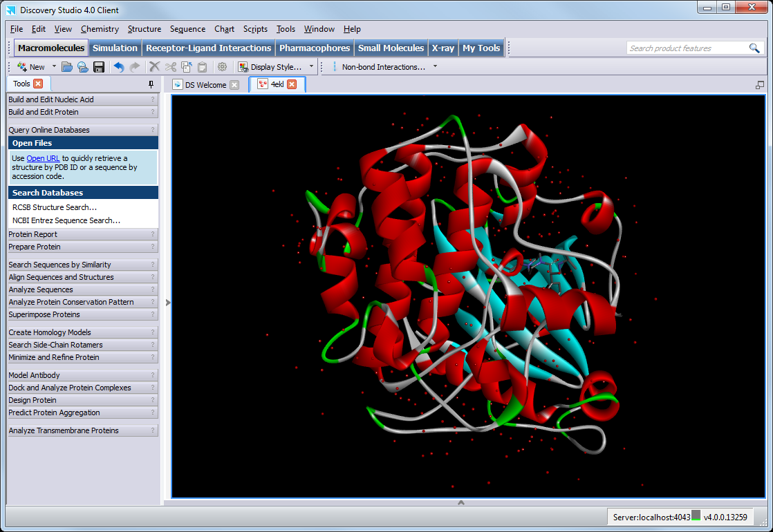
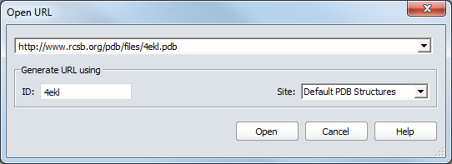
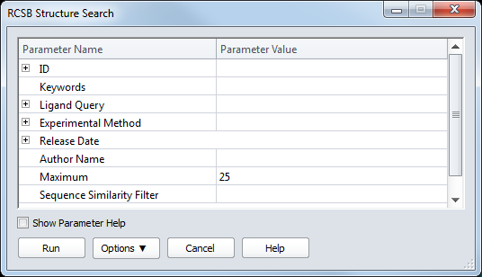
Preparation – Working with PDB Files
Research Collaboratory for Structural Bioinformatics (RCSB) Protein Data Bank files (.ent or .pdb extensions) are primarily designed for storage of biopolymer structures such as proteins and nucleic acids
Open PDB files from the:
Files Explorer (double click or drag-and-drop)
File | Open… command menu
File | Open URL… command menu
RSCB Structure Search protocol
The RCSB Structure Search protocol allows you to search the RCSB PDB
You can search via a number of both simple and advanced criteria, including simple IDs, substructures and sequence motifs

Slide 8
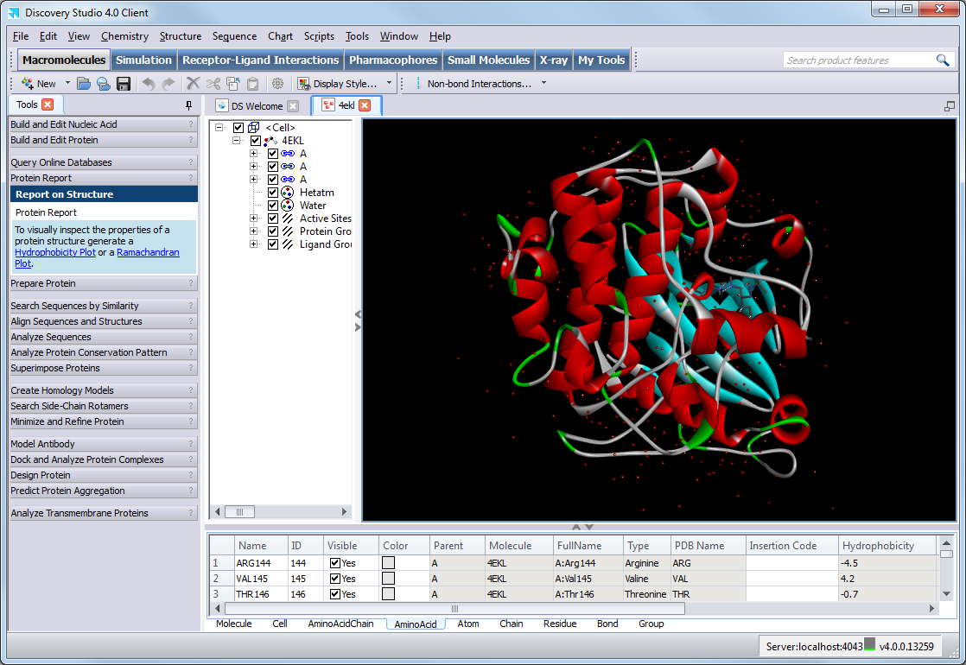

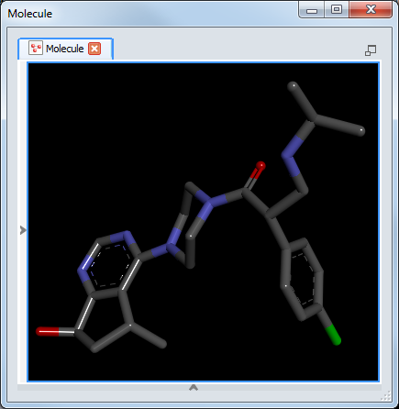
Preparation – Working with PDB Files
.pdb files do not contain the definitions for bond order outside of amino acids and nucleic acids
DS will attempt to determine bond order for small molecules, based on geometry
(Always check before using further )
Bond order
Hybridization
Formal charges
The Protein Report tools extract and process protein structures and summarize information in a Protein Report

Slide 9
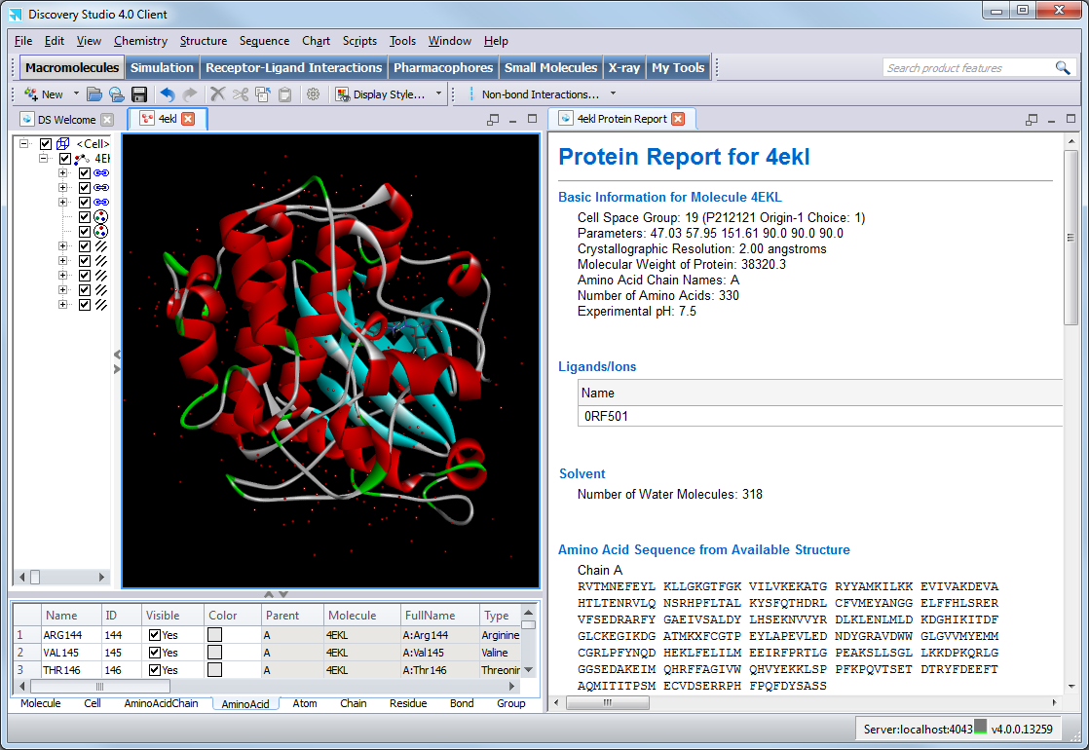
Preparation – Protein Report
The Protein Report summarizes key information about the protein structure(s) in the active Graphics View:
General information
Experimental pH (if available)
Sequence
Comparison of the actual sequence with the PDB SEQRES records
Residues with alternate conformations
A list of incomplete or otherwise invalid residues
Active site definitions
Ligands, ions, etc.
The number of solvent residues
Biomolecule Generation (transformation matrix)
PDB header information

Slide 10
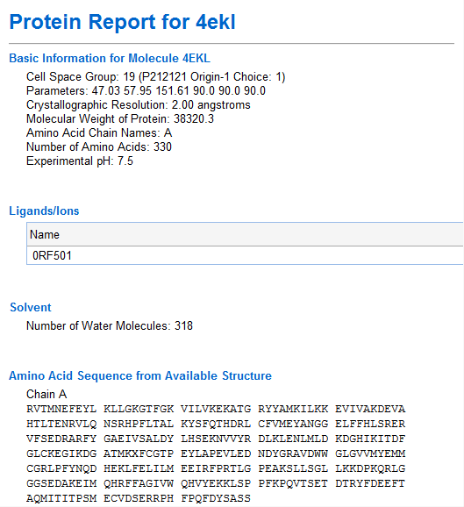
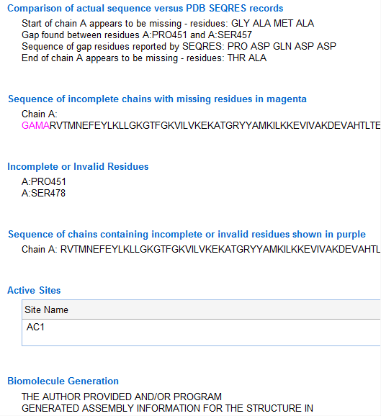
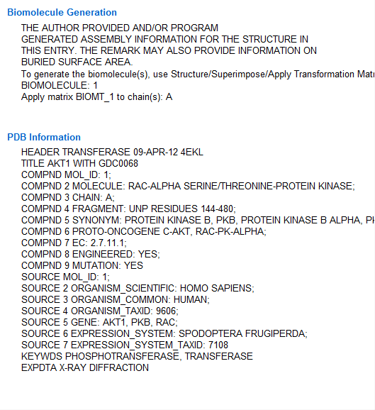
Preparation – Protein Report
Transformation matrices are read in and can be edited or applied using the Structure | Superimpose | Edit Transformation Matrix... or Structure | Superimpose | Apply Transformation Matrix... command menus to create biomolecular complexes

Slide 11
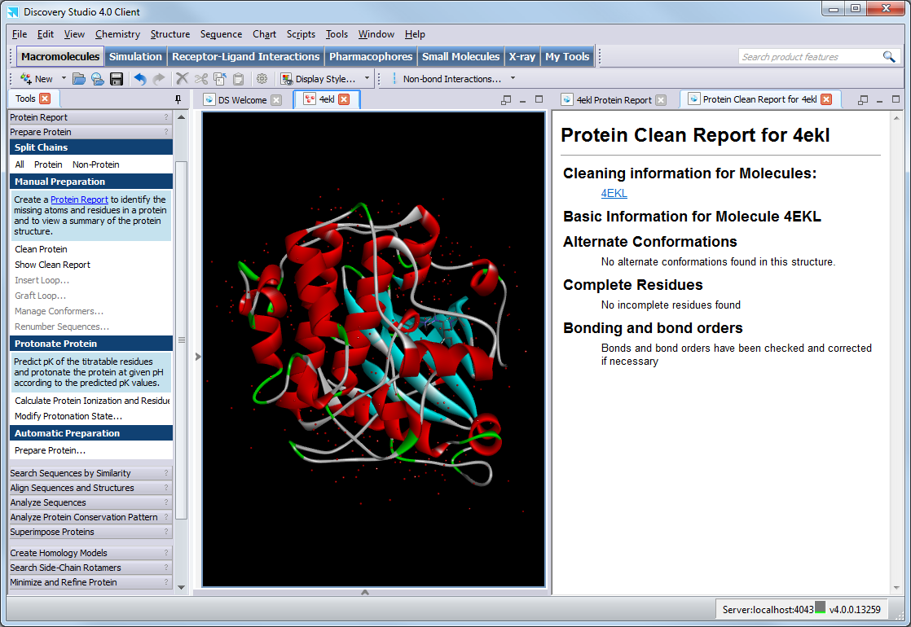
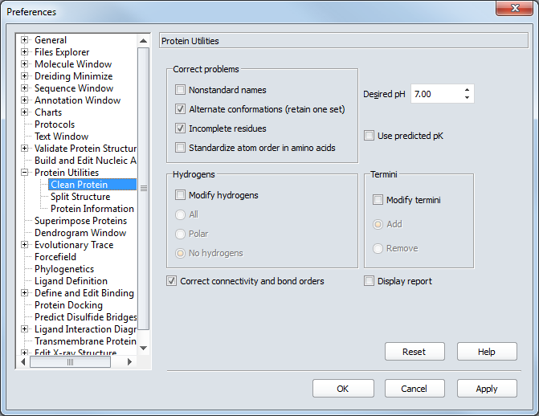
Preparation – Clean Protein
Clean the protein molecule (add missing atoms, correct connectivity, correct names, etc.) and report changes
Clean the protein molecule (add missing atoms, correct connectivity, correct names, etc.) and report changes
Specify which corrective actions Clean Protein will perform e.g. remove alternate conformations, add missing sidechains and hydrogens from the Edit | Preferences… command menu

Slide 12
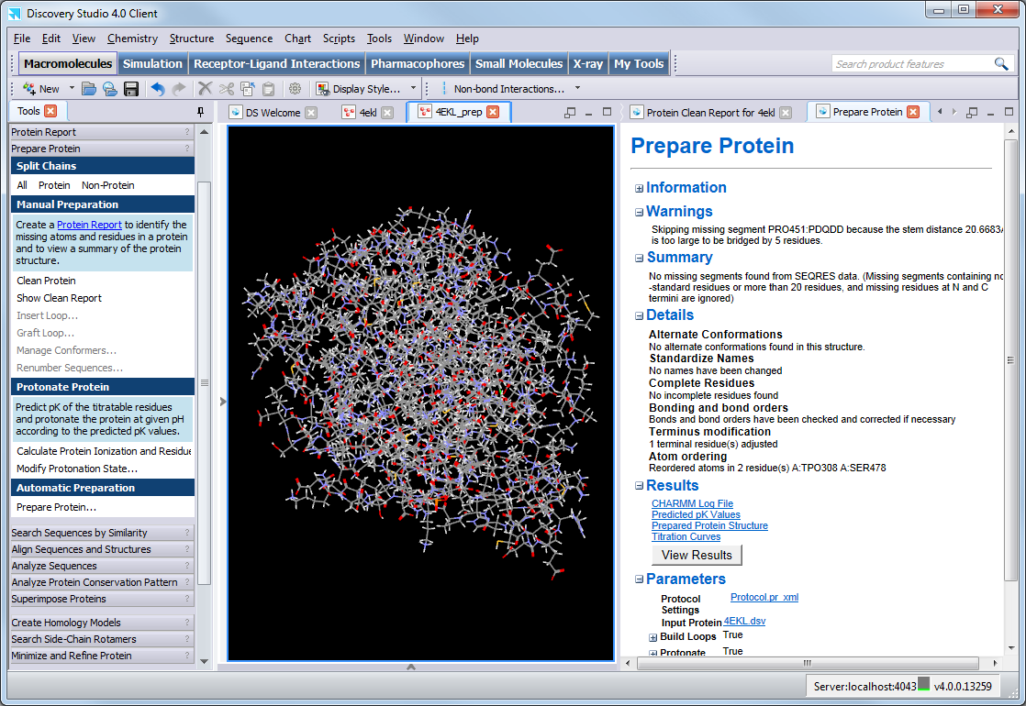
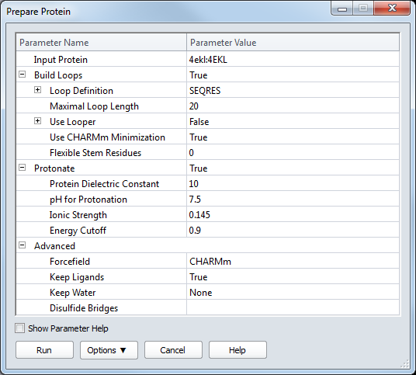
Preparation – Prepare Protein
The Prepare Protein protocol prepares proteins, performing tasks such as:
Inserting missing atoms in incomplete residues
Modeling missing loop regions
Deleting alternate conformations (disorder)
Removing waters
Standardizing atom names
Protonating titratable residues using predicted pKs

Slide 13
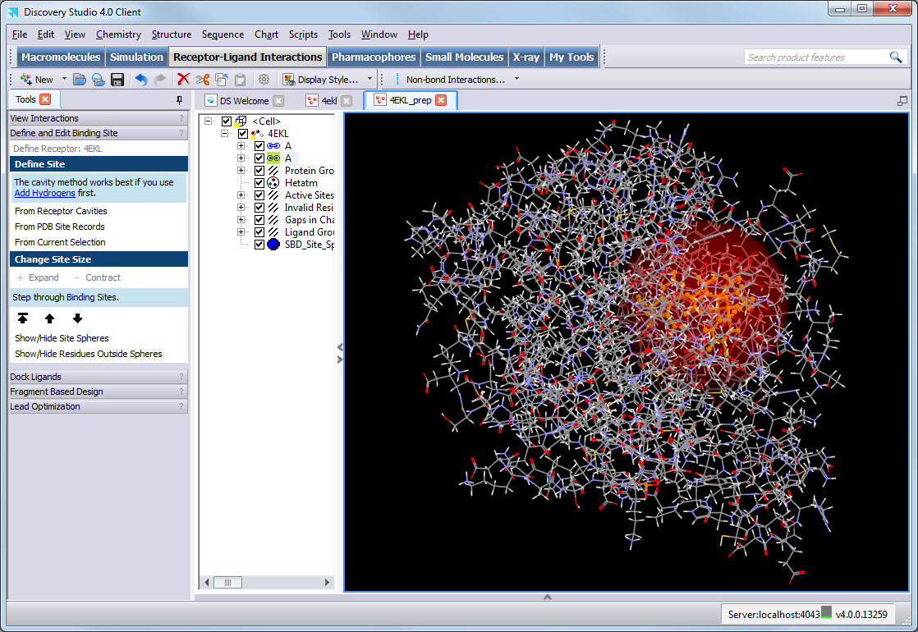
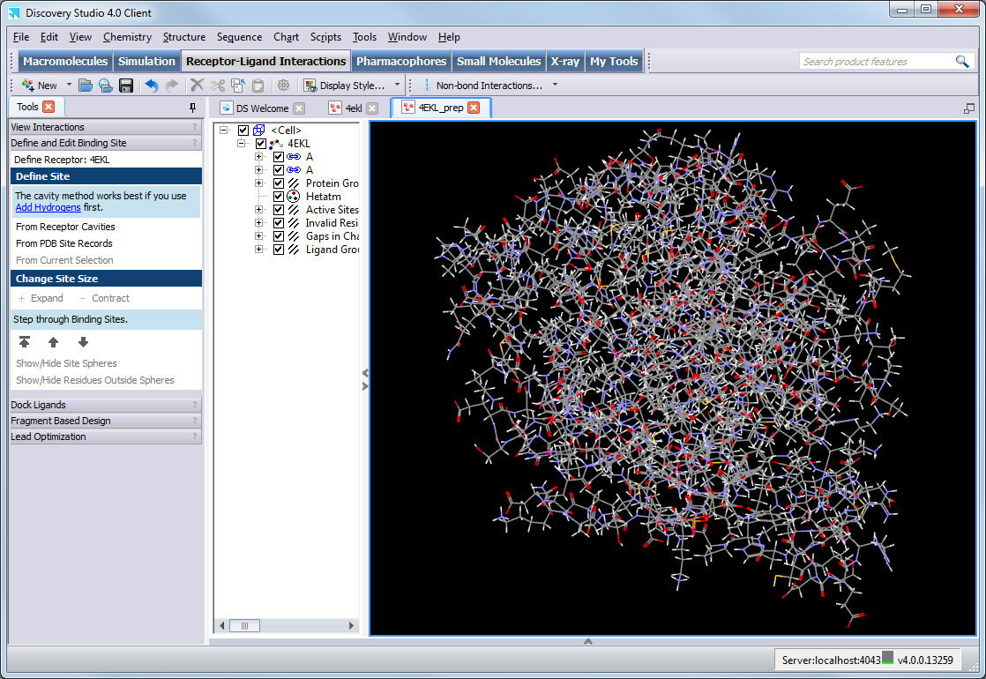
Preparation – Binding Sites
Binding site(s) can be identified from PDB site records or by selecting a bound ligand (Define and Edit Binding Site toolpanel)
When the binding site is unknown you can:
Search for cavities
Use experimental data
  Site-directed mutagenesis studies
  Cross-linking data
  NMR results
Compare target to similar proteins

Slide 14
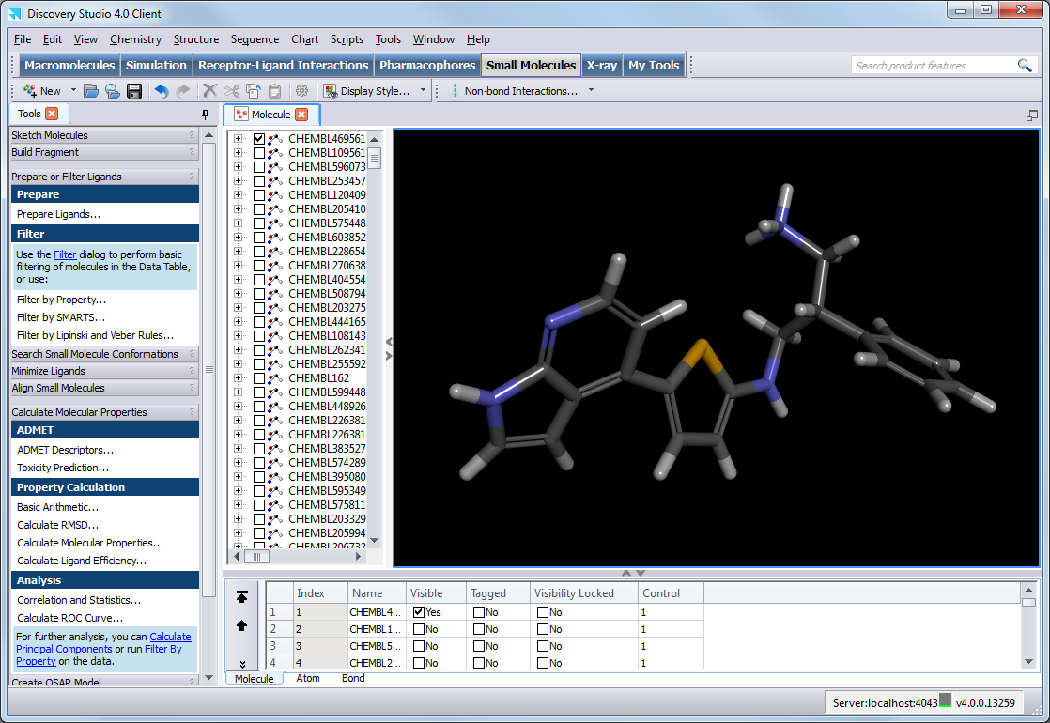
Preparation – Ligand Filtering
You can calculate molecular properties for ligand libraries to prepare for screening:
Include ligands with desirable properties
Filter ligands with undesirable properties and substructures

Slide 15
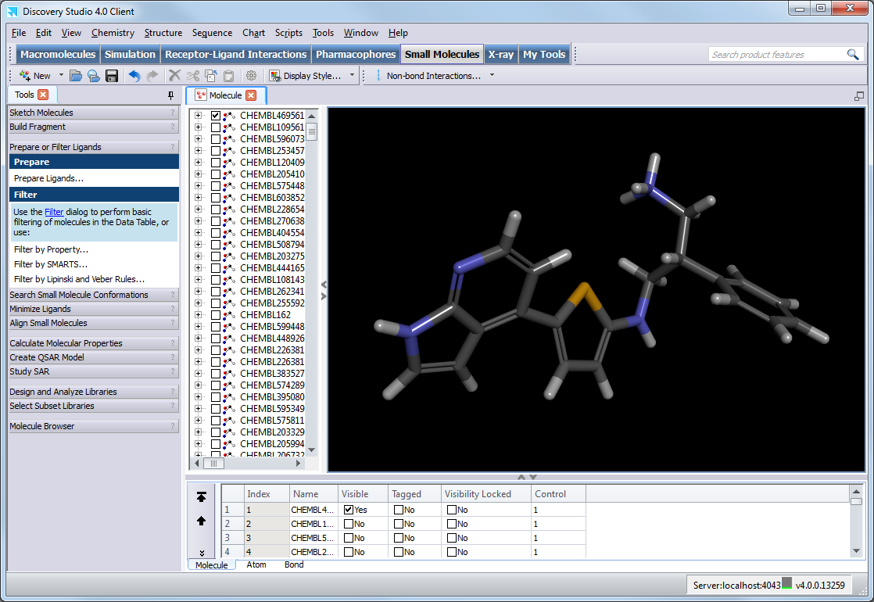
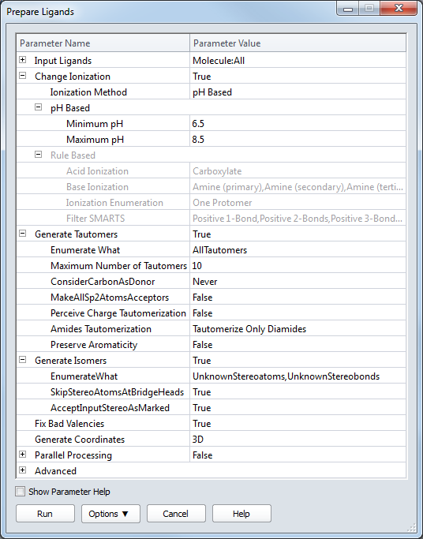
Preparation – Prepare Ligands
Different ligand protonation states, isomers and tautomers typically have different 3D geometries and binding characteristics
The Prepare Ligands protocol can consistently and uniformly prepare ligands and enumerate a number of likely configurations:
  Add hydrogens
  Calculate 3D coordinates
  Enumerate ionization states
  Ionize functional groups
  Generate tautomers and isomers
  Remove duplicates
  Fix bad valencies
  Standardize charges for common groups
  Retain largest fragment

Slide 16
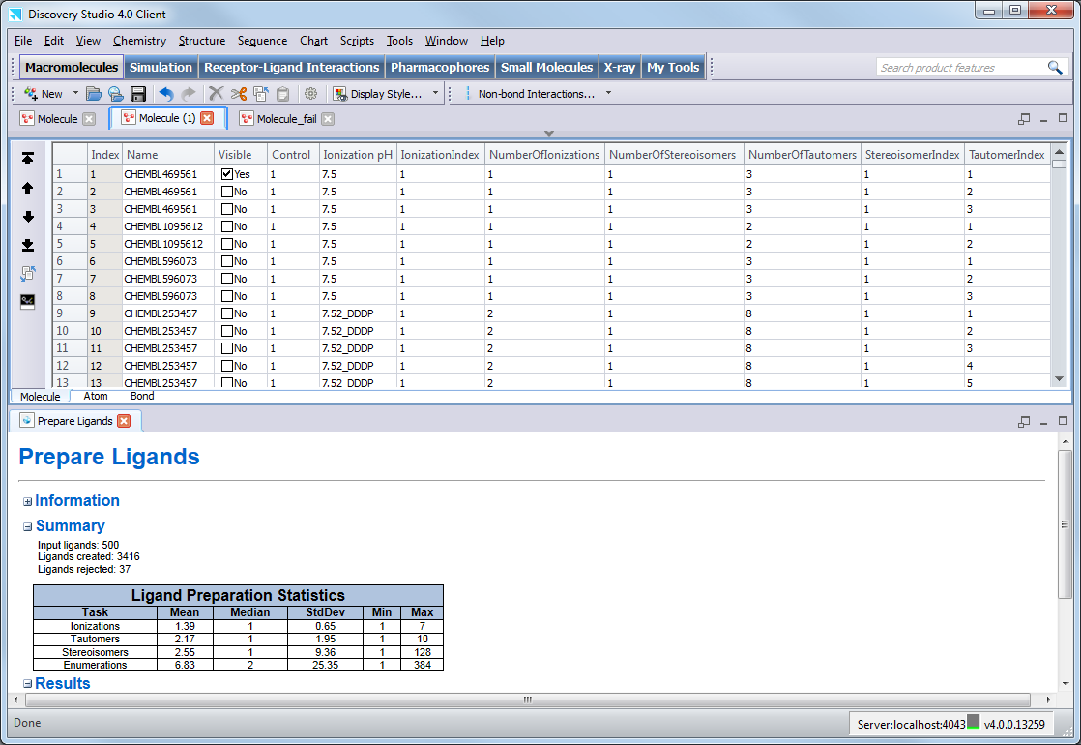
Preparation – Prepare Ligands
Enumeration of all ligand protonation states, and isomer and tautomer configurations can generate too many ligands (!)
  Choose protocol preferences carefully
Names are the same for multiple representations of an original ligand
  Index properties are added to track different ionization states, tautomers, and stereoisomers
During the validation phase of a project you should create a property (e.g. Control) to keep track of active and decoy ligands for later analysis

Slide 17
Docking
Preparation
Protein & Ligands
Different docking methods are available for different screening requirements
LibDock
Hotspots Docking
GOLD
3rd Party
Genetic Algorithm
Docking
CDOCKER
CHARMm-based MD Docking
Library Size
Scoring
Flexible
Flexible Protein Docking
Filtering
Refinement
Analysis
Accuracy

Slide 18
CDOCKER
Preparation
Protein & Ligands
Generate Ligand Conformations
(High Temperature Molecular Dynamics)
Random (Rigid-Body) Rotation
  CDOCKER is a grid-based molecular docking method that employs CHARMm to generate random ligand conformations through high temperature molecular dynamics
Docking
Grid-Based Simulated Annealing
Scoring
Full Minimization
Output Refined Ligand Poses
Filtering
Refinement
Analysis
  The original CDOCKER algorithm was described in:
  Wu G, Robertson DH, Brooks CL III, Vieth M. Detailed analysis of grid-based molecular docking: A case study of CDOCKER - A CHARMm-based MD docking algorithm. J. Comp. Chem. 2003, 13, 1549
  The algorithm used in Discovery Studio is adapted from Prof. Brooks and is a variation of the original method.

Slide 19
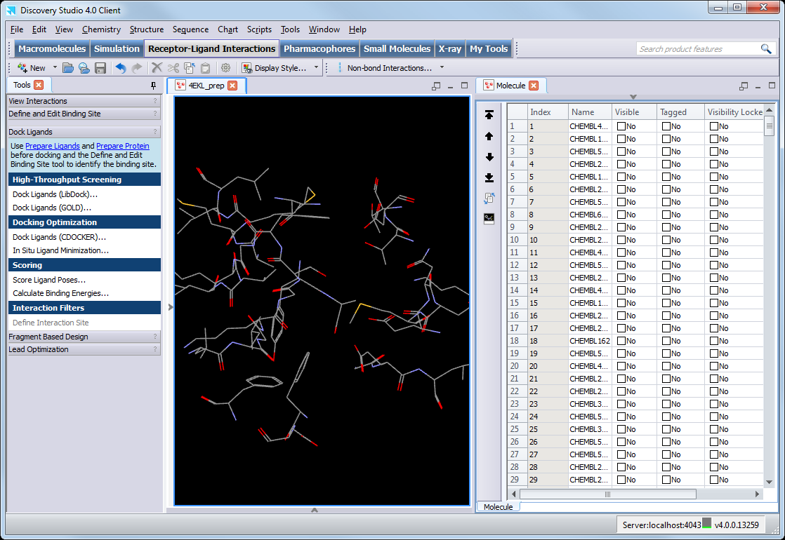
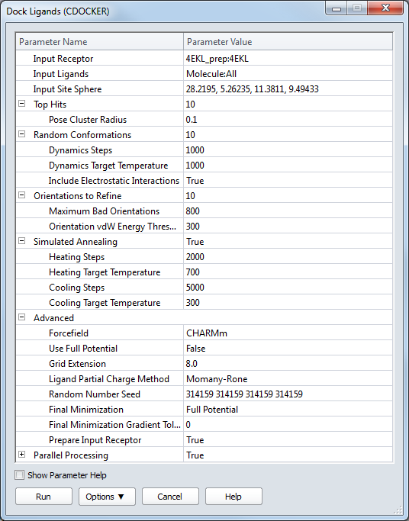
CDOCKER
  CDOCKER can also be used as a docking refinement method if ligands are pre-positioned in the receptor active site (without a site sphere defined)

Slide 20
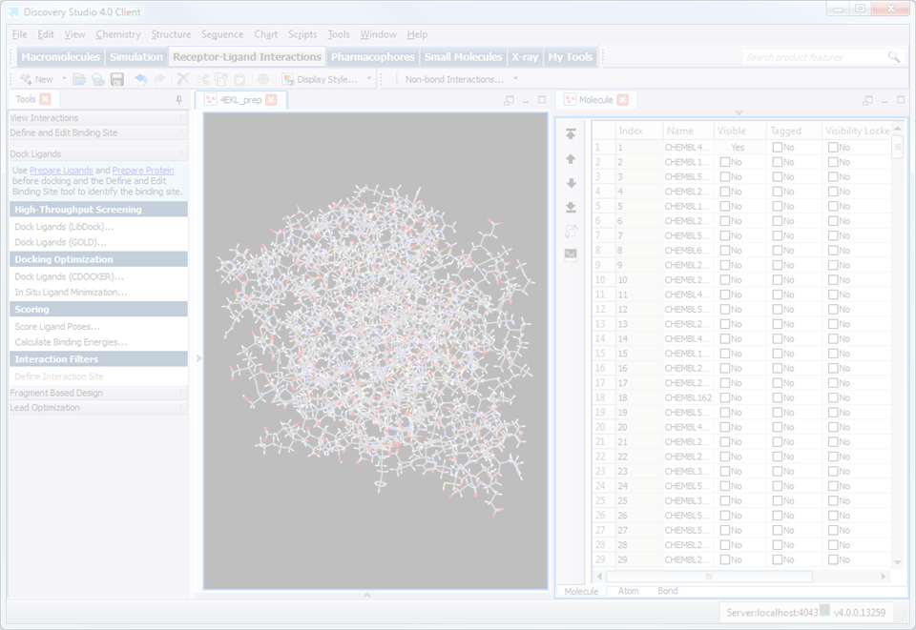
CDOCKER – Key Parameters
During the validation phase of a project you may run multiple jobs to identify the key parameters to optimize the docking
Some key parameters to consider:
If the binding site is particularly large, then you may need to explore more parts of the binding site
  CDOCKER initially positions the ligand in the center of the site sphere
  Input Site Sphere
If the ligands are particularly flexible, then increasing the exploration of docking orientations may help
  Random Conformations
  Orientations to Refine
Ligand chemistry may be better represented with alternative partial charges
  Ligand Partial Charge Method
If key ligands fail to dock, then you may need to increase the energy threshold for acceptance of poses
  Orientation vdW Energy Threshold
If you are looking for very different docking poses, then you can increase the diversity of docked poses
  Pose Cluster Radius

Slide 21
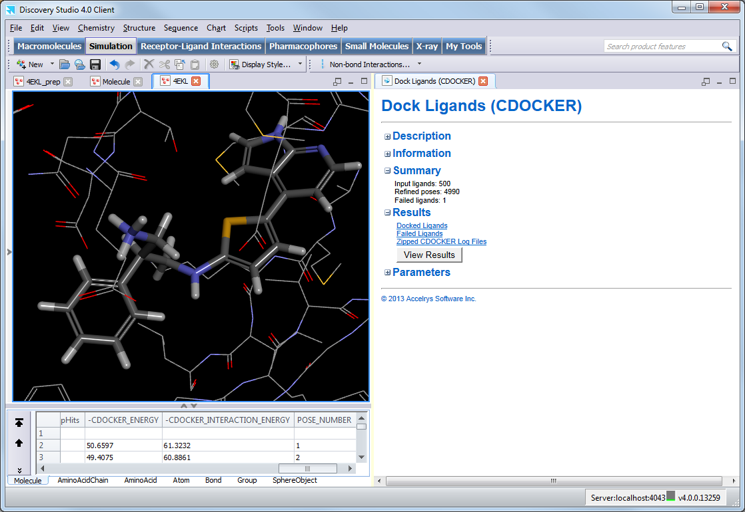
CDOCKER Results
  The docking summary shows the number of refined poses and the ligands which failed to be docked
  Docking poses are ordered by -CDOCKER_ENERGY
  where a higher value indicates a more favorable binding - this score includes internal ligand strain energy and receptor-ligand interaction energy
  The negative of the interaction energy is also reported as -CDOCKER_INTERACTION_ENERGY

Slide 22
Scoring
Preparation
Protein & Ligands
Literature Scoring Functions
Literature Scoring Functions
Methods to rapidly rank ligands by likelihood of correct binding mode
Typically use empirical functions developed by fitting various functional forms, or statistical analysis of known ligand-receptor structures and the frequency of occurrence of specific receptor-ligand interactions
Published scoring functions
  LigScore 1 & 2
  Piecewise Linear Potential (PLP) 1 & 2
  Potential of Mean Force (PMF) & PMF04
  Jain
  Ludi 1, 2 , & 3
Docking
Scoring
Energy-Based Functions
Energy-Based Functions
Binding energies can be calculated based on
Interaction energies calculate the nonbonded interactions (i.e., the van der Waals term and the electrostatic term) between two sets of atoms
  Can be calculated using CHARMm or QM/MM forcefields
Filtering
Refinement
Analysis
Consensus scoring, and pareto sorting and optimisation are available for working with multiple functions

Slide 23
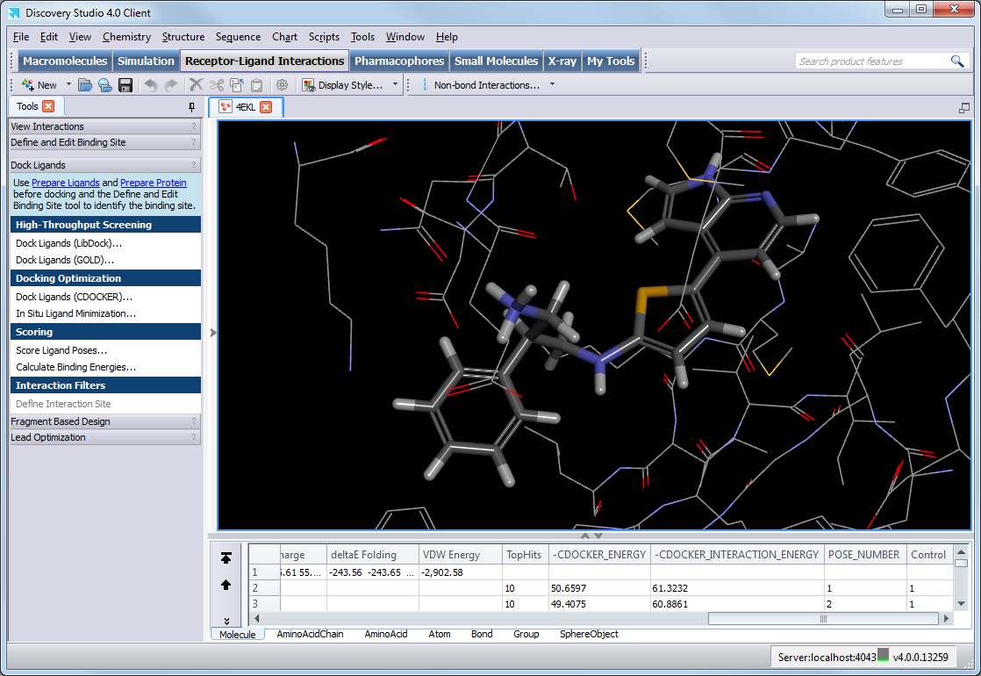
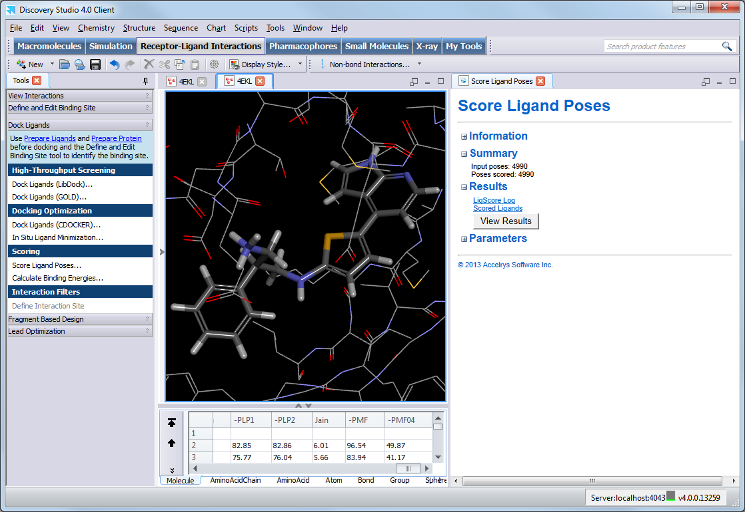
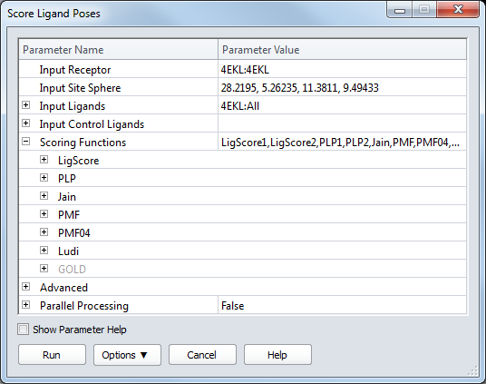
Scoring
  Scoring functions are calculated and added as properties which can be sorted and used to prioritize docking poses
  Details of the scoring functions are available in the Documentation
  GOLD scoring functions are only available with a license from the CCDC
  http://www.ccdc.cam.ac.uk/Solutions/GoldSuite/Pages/GOLD.aspx

Slide 24
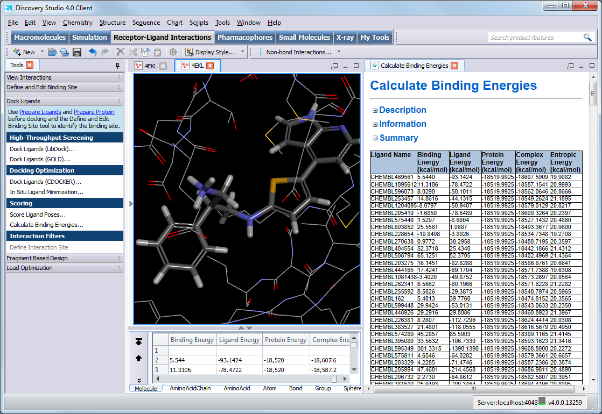
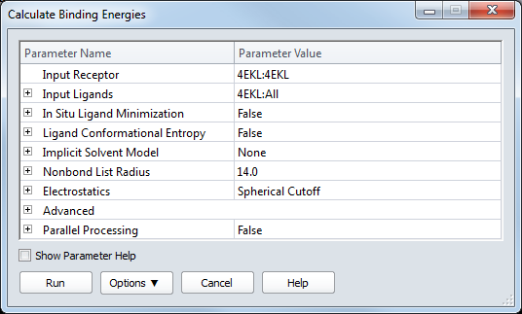
Binding Energies
The free energies of binding energies can be calculated based on
  Multiple implicit solvation models available to model effect of water:
  Implicit Distance-Dependent Dielectrics
  Implicit Generalized Born
  Generalized Born with Molecular Volume (GBMV)
  Generalized Born with a Simple Switching (GBSW)
  Poisson Boltzmann with non-polar Surface Area (PBSA)
  Recommend GBMV or PBSA for greatest accuracy
  Use the same ligand partial charge estimation you used for the docking

Slide 25
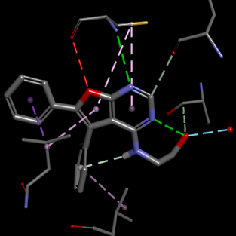
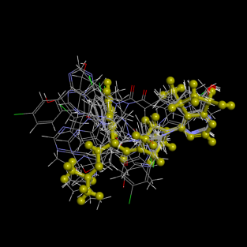
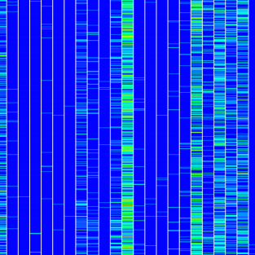
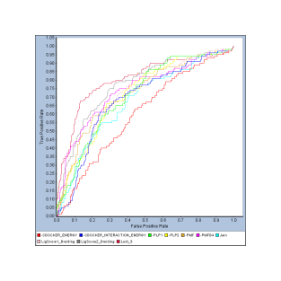
Docking Workflow
Preparation
Protein & Ligands
There are numerous tools to analyze and process docking results
Some tools are used predominantly during the validation phase of a project
Other tools can be used to further refine the docking poses and filter those poses less likely to be correct to enrich results
Which tools you use, and the sequence in which they may be utilized, depend on literature and experimental information you may have available and the objectives and constraints of your project
Docking
Non-Bond Interactions
RMSD
Scoring
Analyze Ligand Poses
ROC
Filtering
Refinement
Analysis

Slide 26
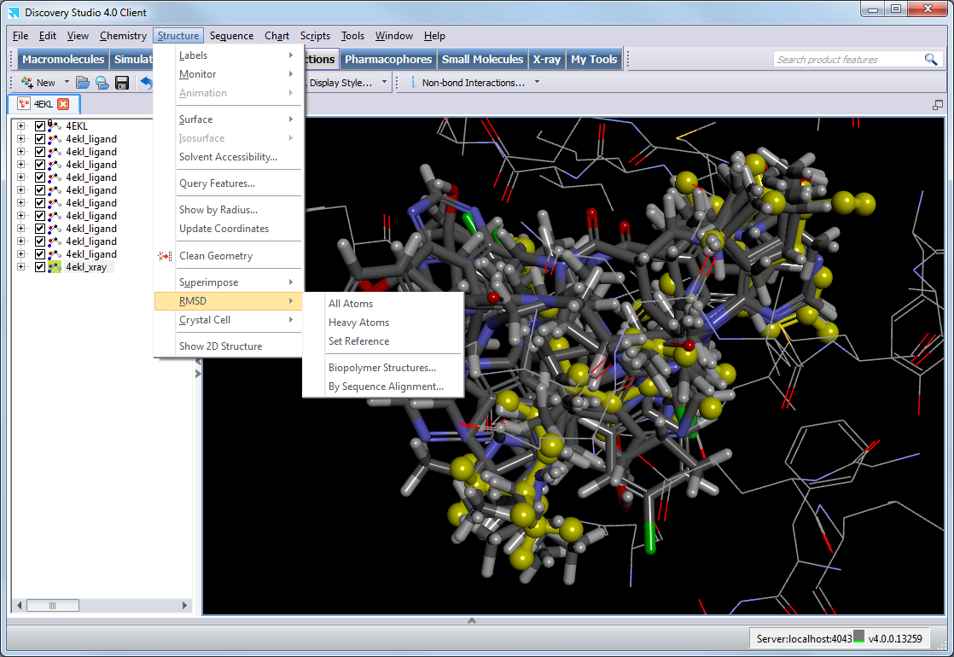
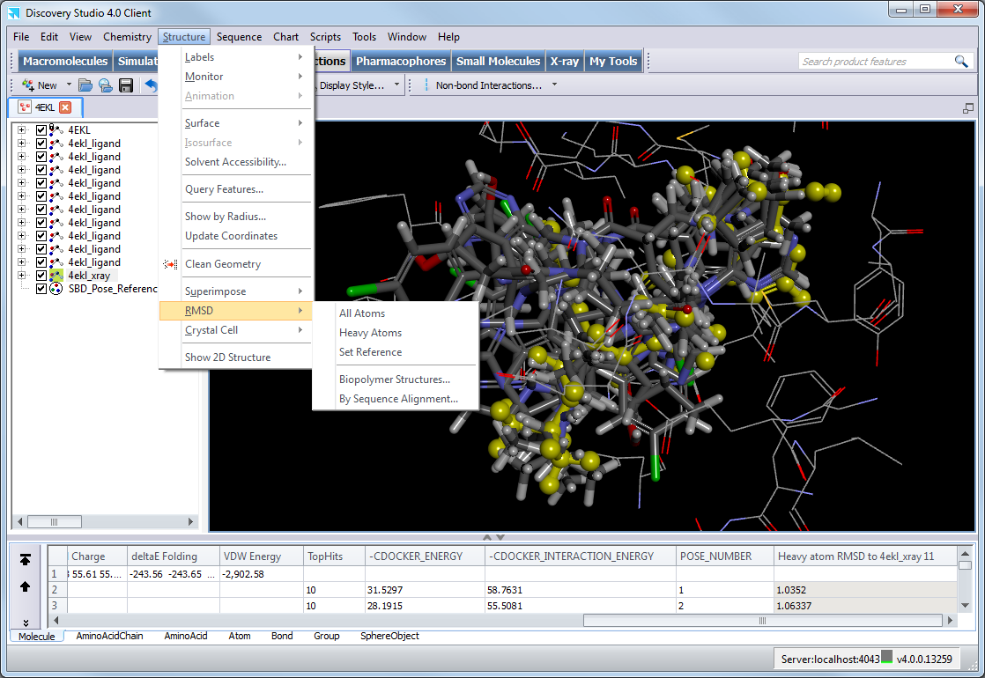
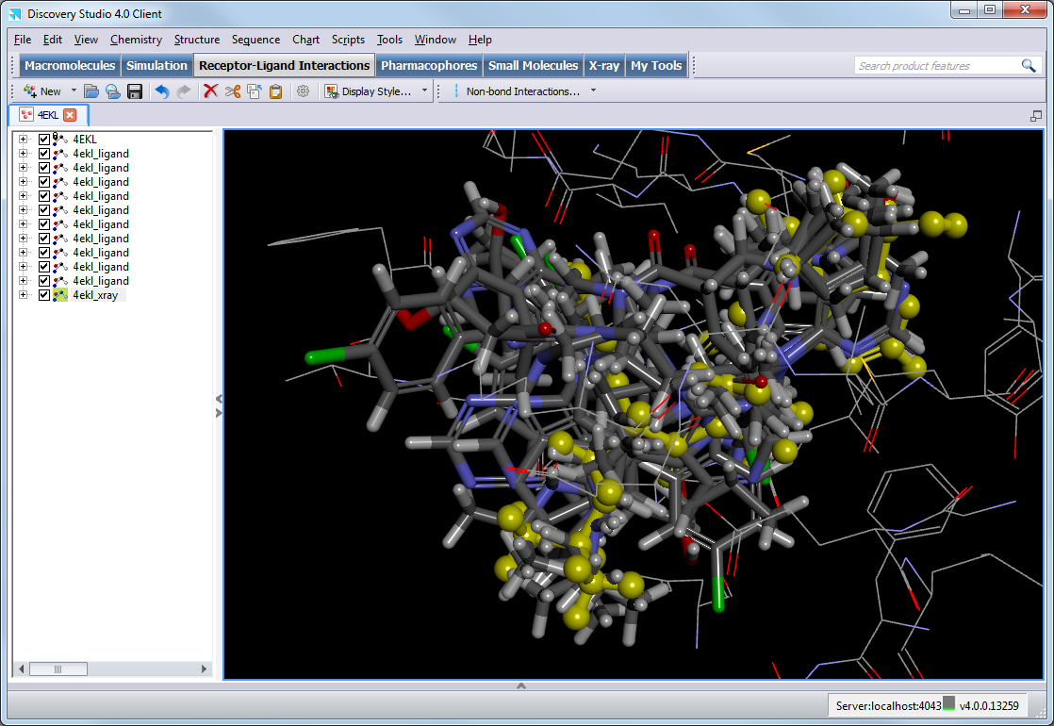
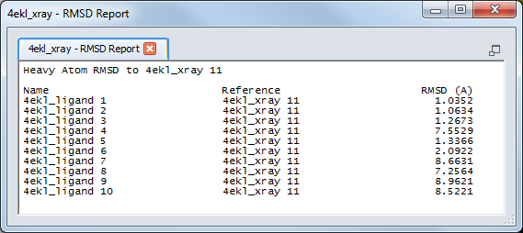
Analysis - RMSD
RMSD calculations can be useful during the validation phase of a project if you are optimizing docking parameters based on how well you can reproduce the x-ray ligand pose
Select x-ray ligand and Set Reference
Select docking poses and calculate RMSD based on All Atoms or Heavy Atoms

Slide 27
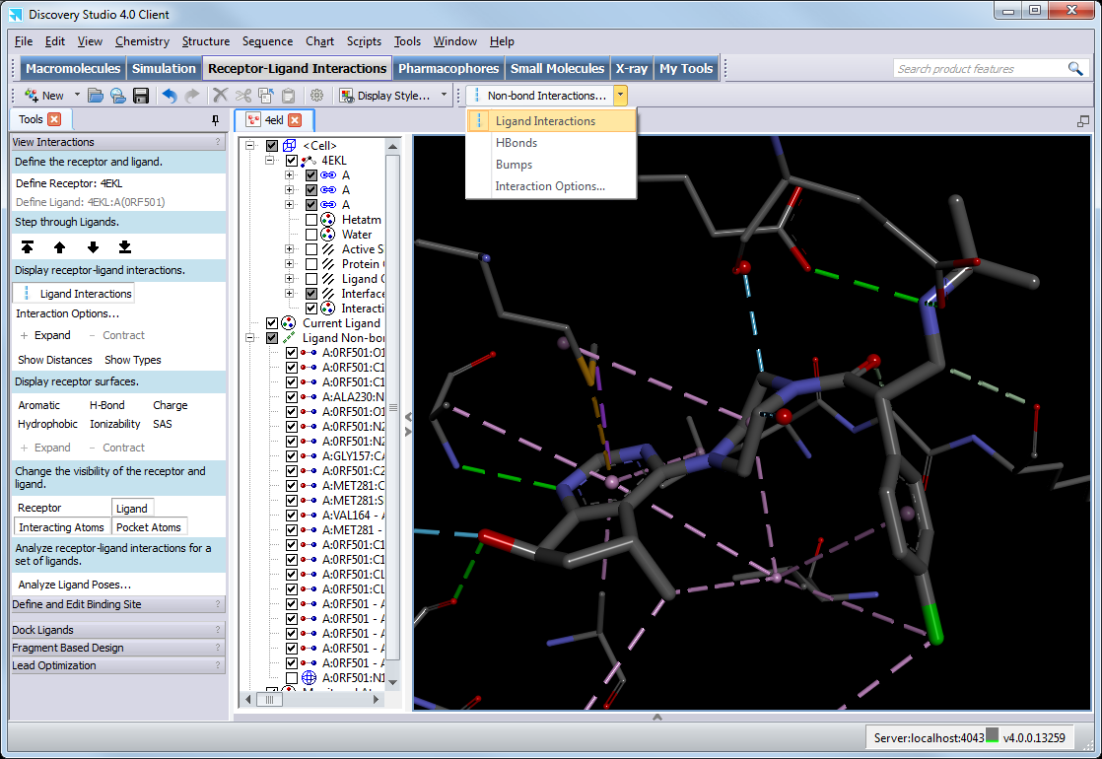
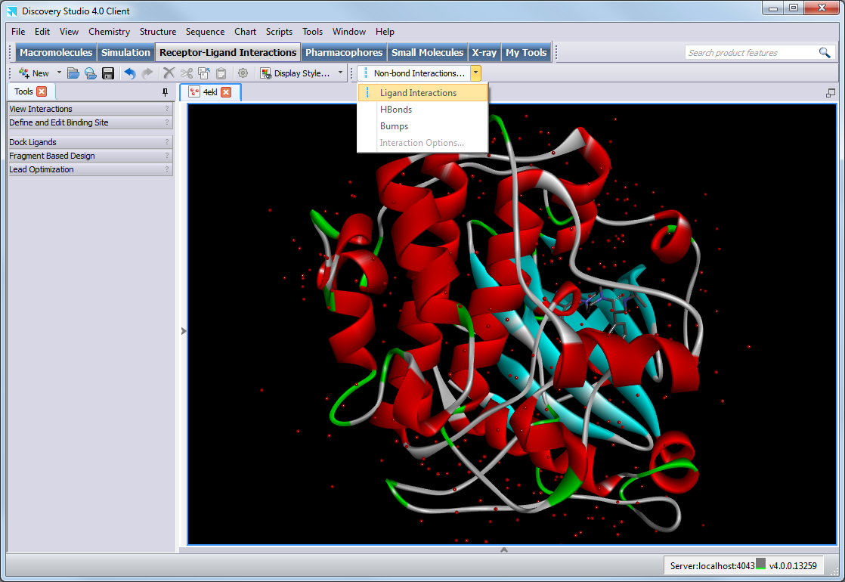
Analysis - Non-Bond Interactions
Comprehensive perception of non-bond interactions can reveal important and useful interactions significant to binding
You can perform a quick analysis of protein-ligand interactions identifying favorable, unfavorable and unsatisfied interactions
Expand and contract to display additional ‘shells’ of interactions to understand the supporting interactions of the residues that interact with the ligand

Slide 28
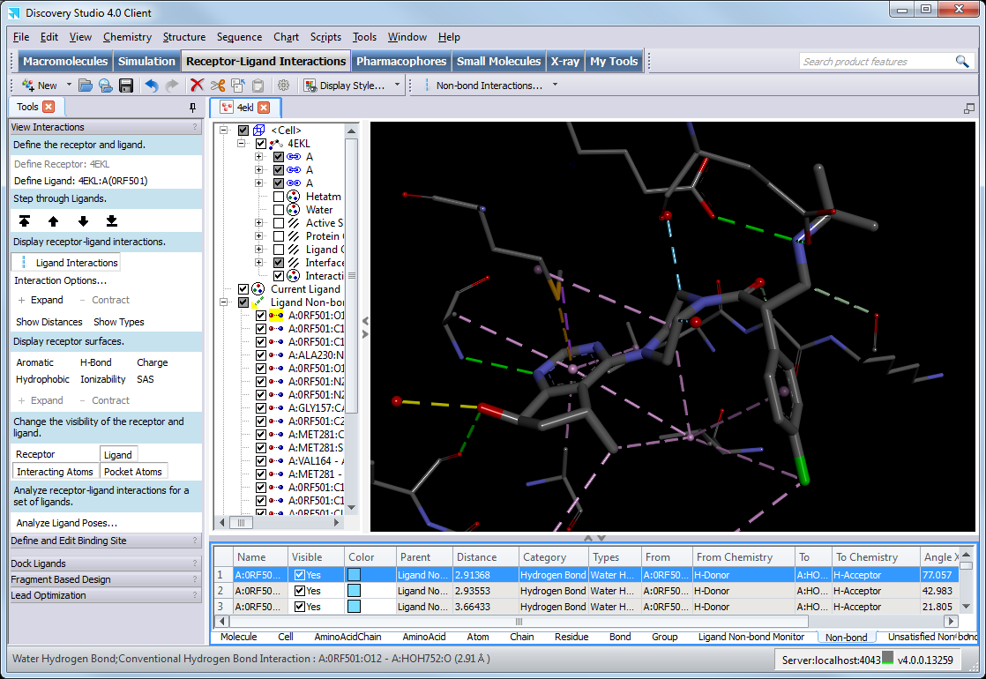
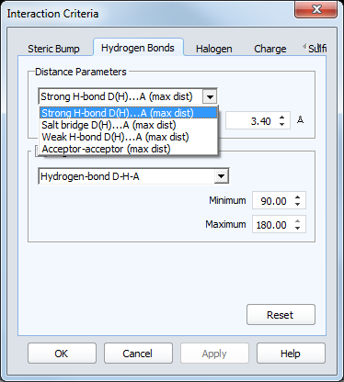
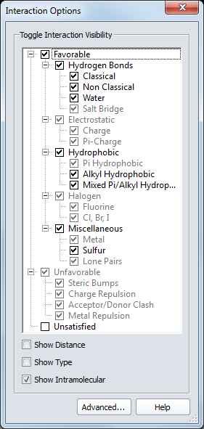
Analysis - Non-Bond Interactions
You can control the visualization of interactions easily and modify the interaction perception to be more strict or loose
Interaction details available with selection and in the Non-bond tab of the Data Table
Interaction details available with selection and in the Non-bond tab of the Data Table

Slide 29
Analysis - Non-Bond Interactions
Favorable
(See below)
Unfavorable
  Steric Bumps
  Charge Repulsion
  Acceptor-Acceptor clashes
  Donor-Donor clashes
Unsatisfied
  Hydrogen bond donor
  Hydrogen bond acceptor
  Charged atoms
Charge
  Attractive Charges
  Salt Bridge
  Pi-Cation
  Pi-Anion
Halogen
  Halogen (Fluorine)
  Halogen (Cl, Br, I)
Hydrophobic
  Pi-Pi Stacked
  Pi-Pi T-Shaped
  Amide-Pi Stacked
  Alkyl
  Pi-Sigma
  Pi-Alkyl
Hydrogen Bond
  Conventional Hydrogen Bond
  Carbon Hydrogen Bond
  Pi Donor Hydrogen Bond
  Water Mediated Hydrogen Bond
  Water Hydrogen Bond
  Salt Bridge
Other
  Metal-Acceptor
  Pi-Sulfur
  Sulfur-X
  Pi-Lone Pair

Slide 30
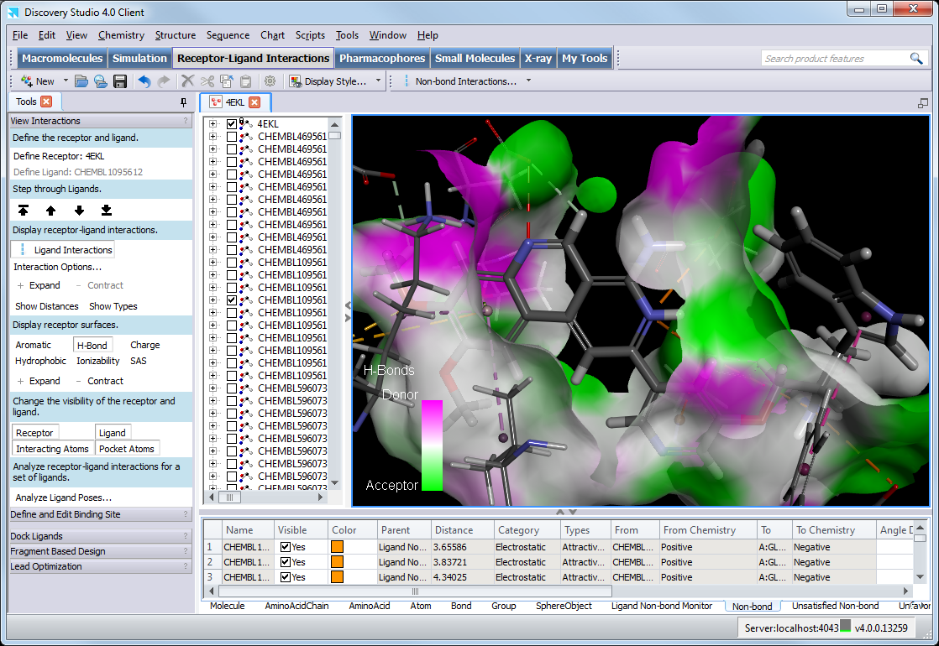
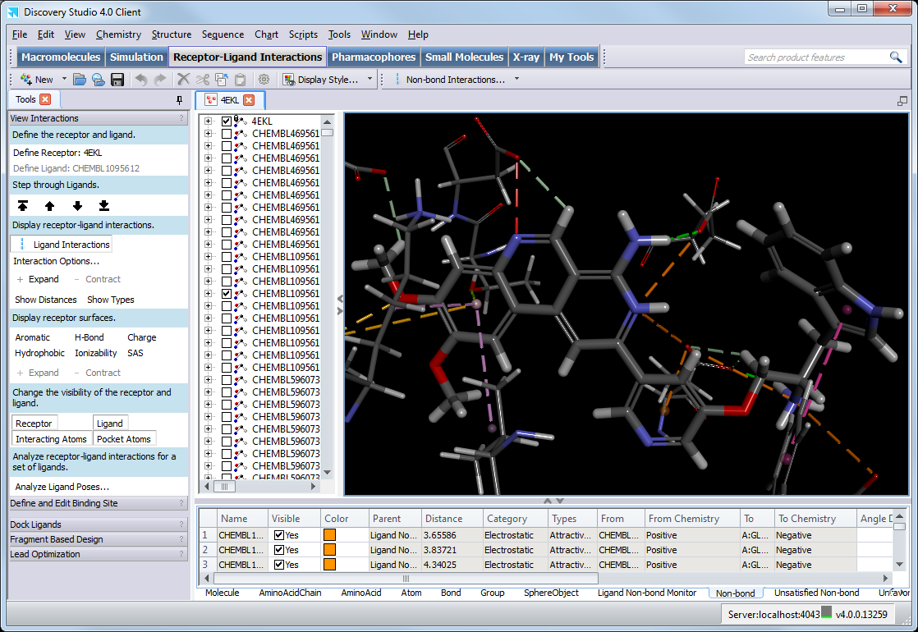
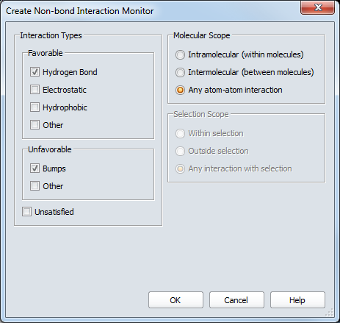
Analysis - Non-Bond Interactions Poses
Alternatively, non-bond interaction monitors can also be created with specific control of interactions, and molecular and selection scope
Non-bond interactions can also be viewed for docking poses
Scrolling through the poses will update the ligand and display only those residues interacting with the ligand
You can also add receptor surfaces to more easily visualize the binding site cavity

Slide 31
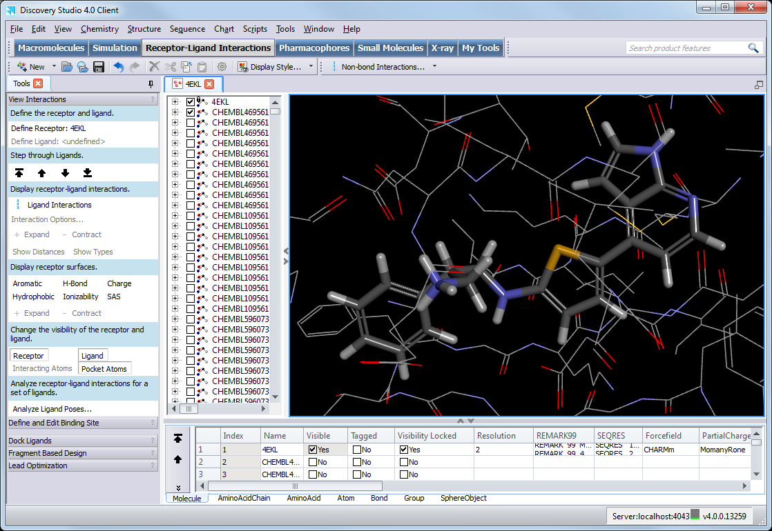
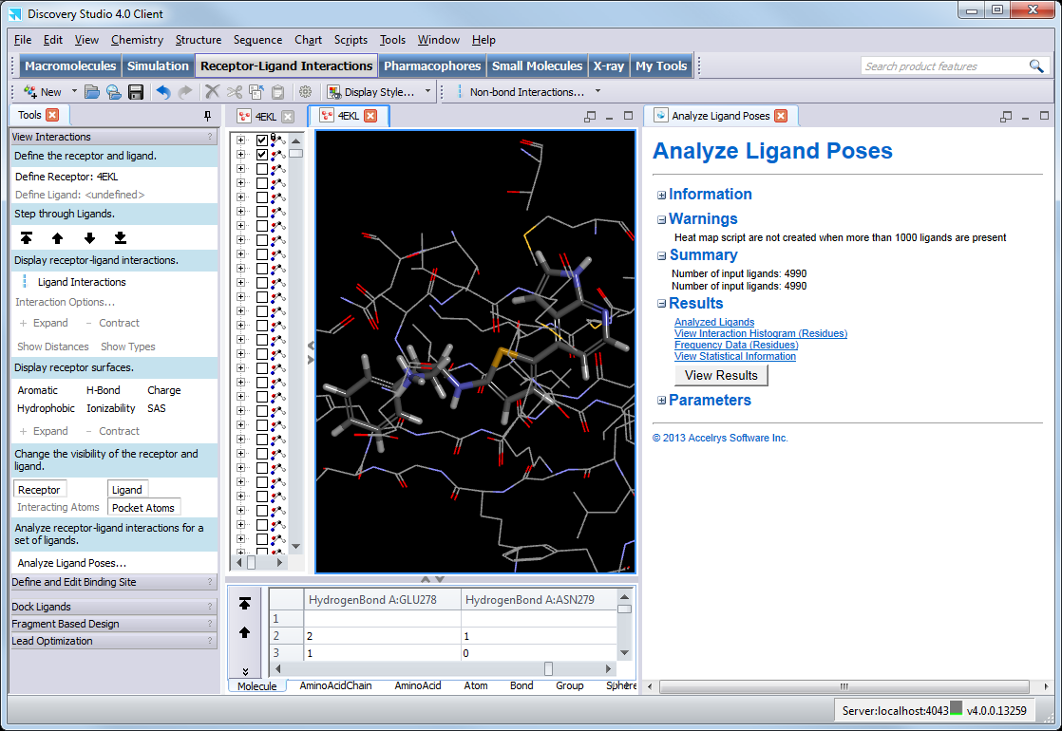
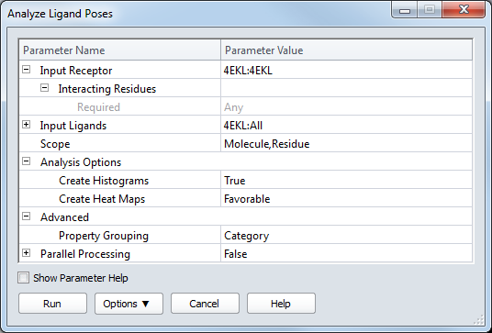
Analysis - Analyze Ligand Poses
Non-bond interactions for numerous docking poses are more easily analyzed as molecular properties, and can be calculated with the Analyze Ligand Poses protocol
Non-bond interactions for numerous docking poses are more easily analyzed as molecular properties, and can be calculated with the Analyze Ligand Poses protocol

Slide 32


Analysis - Analyze Ligand Poses
Frequency histograms summarize the different protein residue interactions calculated for the docked poses
The residue axis is the same for all of the histograms so that it is easy to compare the different interactions
Statistical Residue Analysis summarizes the interaction count and lists the 5 most frequently encountered residues for each interaction type

Slide 33



Analysis - Analyze Ligand Poses
Non-bond interaction properties are added and sorted by interaction category
Properties can also be sorted by scope, such as by residue sequence
Decoys
Interaction properties can be charted with heat maps
Columns represent interactions (e.g. residues forming hydrophobic interactions); rows represent ligand poses
Which interactions can discriminate the actives from the decoys?
Actives
Use the filtering in the Data Table or the Filter by Property protocol to enrich the results

Slide 34



Analysis - ROC
ROC curves are used in the validation phase to analyze the enrichment based on the scores of a set of control poses
You can use this to identify which scoring function(s) best discriminate or prioritize actives over decoys, and then use these scoring function(s) in the screening phase
The number of validation ligands (total, actives) can be added, in case some ligands fail to dock – or else the number of ligands is derived from the input file

Slide 35

Analysis - ROC
Hit rate plots can be generated from the Chart command menu, but ROC curves are better as the best pose per scoring function is identified for generating the ROC curves for each scoring function
The higher the area under the ROC curve the better the scoring function is able to prioritize actives over the decoys

Slide 36
Receiver Operating Characteristic
Confusion Matrix
False Positives
False Negatives
 | in vitro
in silico | Actives | Inactives
Selected | True positives (TP) | False positives (FP)
Discarded | False negatives (FN) | True negatives (TN)
 | S_{e} | S_{p}
Number of Ligands
Discarded
Selected
Inactives
Actives
Threshold
Score
Sensitivity (S_{e}) - Ability to retrieve actives (true positive rate)
Specificity (S_{p}) - Ability to discard inactives (true negative rate)
ROC analysis provides tools to select possibly optimal models and to discard suboptimal ones independently from the cost context or the class distribution

Slide 37




Analysis – Refinement - Filtering
Preparation
Protein & Ligands
RMSD
Non-Bond Interactions
Analyze Ligand Poses
ROC
The Analysis/Refinement/Filtering tools can be used along with experimental and literature information to optimize the docking
Identifying the best scoring function(s) to prioritize actives over decoys, the non-bond interaction properties that discriminate actives/decoys, and generating filters which can enrich the validation dataset are vital to developing the methodology/protocol which you will then use in screening a larger library of unknown ligands
These scoring function(s), the non-bond interaction properties, and filters are then used to reduce and prioritize the screening results to maximize the probability of success
Docking
Scoring
Validation
Filtering
Refinement
Analysis
Screening

Slide 38
Constrained Docking
Preparation
Protein & Ligands
If you have experimental and literature information which you wish to use to restrain the docking there are two approaches which you may take:
Perform the docking as usual, and use non-bond interactions properties or pharmacophore filtering tools to remove unsuitable poses
Use the ligand-pharmacophore mapping tools
Create a pharmacophore in the protein binding site
  From a bioactive ligand: use the Auto Pharmacophore Generation or Feature Mapping protocols
  From a protein-ligand complex: use the Receptor-Ligand Pharmacophore Generation protocol
  Use the Interaction Generation protocol and pharmacophore editing tools
Use the Ligand Pharmacophore Mapping or Screen Library protocol to map ligands to the pharmacophore
  The Ligand Pharmacophore Mapping protocol allows partial mapping of pharmacophore features
  The Screen Library protocol allows partial mapping of pharmacophore features, required features and group features
Select top ligand poses
Use the Dock Ligands (CDOCKER) protocol (without a site sphere) to refine ligands in binding site
Docking
Scoring
Filtering
Refinement
Analysis

Slide 39
LibDock
Preparation
Protein & Ligands
  LibDock is a high-throughput docking method which matches ligand conformations to polar and apolar receptor interaction sites (hotspots)
Generate Receptor Hotspots
(Polar and apolar hotspots)
Generate Ligand Conformations
(Multiple on-the-fly methods, or pre-generated)
Docking
Match Conformations to Hotspots
Scoring
Final BFGS Optimization and Scoring
Output Docked Ligand Poses
Filtering
Refinement
Analysis
  Diller DJ, Merz ML III. High Throughput Docking for Library Design and Library Prioritization. Proteins: Structure, Function, and Genetics, 2001, 43, 113-124

Slide 40

LibDock
  LibDock is an extremely fast docking algorithm, and can be used as a first-pass screening method before further refinement with CDOCKER
  LibDock can perform docking in four different modes:
  High Quality
  Fast Search
  Fast Search for SASA
  User Specified
  LibDock poses can be further minimized with various implicit solvation models and flexible residues defined specifically or by a site sphere

Slide 41

LibDock Results
  The docking summary shows the number of refined poses and the ligands which failed to be docked
  Docking poses are ordered by LibDockScore
  where a higher value indicates a more favorable binding
  If you chosen to minimize the ligand poses, then –In-Situ Starting/Final Energy is reported, and the LibDockScore is for the pose before the refinement

Slide 42
Flexible Docking
Preparation
Protein & Ligands
Generate Receptor Side Chain Conformations (ChiFlex algorithm)
  Flexible Docking allows for receptor flexibility during the docking of flexible ligands, allowing the receptor to adapt to different ligands in an induced-fit model
Generate Receptor Hotspots for Receptor Conformations
Docking
Generate Ligand Conformations
(On-the-fly methods, or pre-generated)
Match Conformations to Hotspots
Scoring
Refine Protein Side Chain Conformations
(ChiRotor algorithm)
Filtering
Refinement
Analysis
Simulated Annealing and Energy Minimisation of Poses
  Existing protein conformations can be used in lieu of generating side chain conformations
  Koska J, Spassov VZ, Maynard AJ, Yan L, Austin N, Flook PK, Venkatachalam CM. Fully automated molecular mechanics based induced fit protein-ligand docking method, J. Chem. Inf. Model. 2008, 48, 1965-1973.

Slide 43


Flexible Docking
  The Flexible Docking protocol is found in Receptor-Ligand Interactions | Docking in the Protocols Explorer
  Selected Residues define the residues for creating protein conformations and side-chain refinement in the presence of the ligand
  Protein conformations can be generated without proceeding with the flexible docking, analyzed and a selection of conformations chosen to be re-used in the flexible docking

Slide 44

Flexible Docking Results
  The Protein Conformation property allows you to track the protein conformation used to dock that ligand pose in the <receptor>-conformations.mol2.gz file
  The ligand poses include a new property Receptor.Positions which contains the coordinates of the corresponding flexible receptor atoms
  These are used in other protocols like Score Ligand Poses and Analyze Ligand Poses to correctly calculate the ligand scores and interactions with the corresponding protein conformation

Slide 45
Additional Training
Accelrys Training
  http://accelrys.com/services/training/life-science/index.html
General
Discovery Studio Pipeline Pilot Integration
Scripting
Protein Based Modeling
Protein Homology Modeling
Antibody Modeling
Protein-Protein Docking
Simulations
QM/MM
Ligand Based Design
Ligand Based Modeling
Pharmacophore Modeling in Discovery Studio
Common Feature Pharmacophore Generation
3D QSAR Pharmacophore Generation
Receptor-Based Pharmacophores
Fragment Based Drug Design in Discovery Studio
QSAR
Library Design and Analysis
Structure-Based Design - Docking

Slide 46
Additional Information
Accelrys Support
  http://accelrys.com/customer-support/contact.html
Accelrys User Community
  https://community.accelrys.com
U.S.
7am -5pm (Pacific Time)
Toll Free: 1-800-756- 4674
Tel: (858) 799-5509
Fax: (858) 799-5102
support@accelrys.com
Europe
09:00 - 17:30 (Central EU time)
Tel: +44 1223 228822
UK local rate:
Tel: +44 845 741 3375
Fax: +44 1223 228501
Switzerland:
Tel: +41 61 486 8880
Fax: +41 61 486 8889
Germany:
Tel: +49 221 160 25255
support@accelrys.com
Japan
10:00 - 17:00 (Japan Time)
Toll Free: 0120-712655
Tel: 81 3 5532 3860
Fax: 81 3 5532 3801
support-japan@accelrys.com

