Slide 1
Antibody Modeling
An antibody modeling workflow in Discovery Studio

Slide 2
Copyright and Disclaimer
Copyright © 2013 Accelrys Software Inc. All rights reserved.
This product (software and/or documentation) is furnished under a License/Service Agreement and may be used only in accordance with the terms of such agreement.
Acknowledgments and References
Accelrys may grant permission to republish or reprint its copyrighted materials. Requests should be submitted to Accelrys Scientific and Technical Support, either through email to support@accelrys.com or in writing to:
    Accelrys Support
    5005 Wateridge Vista Drive,
    San Diego, CA 92121,
    USA
This presentation may contain information on the roadmap and future software development efforts and is intended to outline our general product direction. It should not be relied on in making a purchasing decision.
In addition, information disclosed in this presentation and related documents, whether oral or written, is confidential or proprietary information of Accelrys. It shall be used only for the purpose of furthering our business relationship, and shall not be disclosed to third parties.

Slide 3
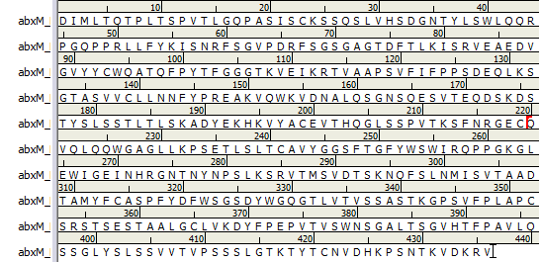
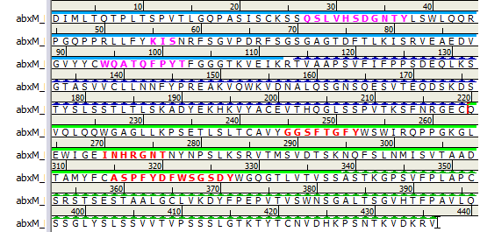
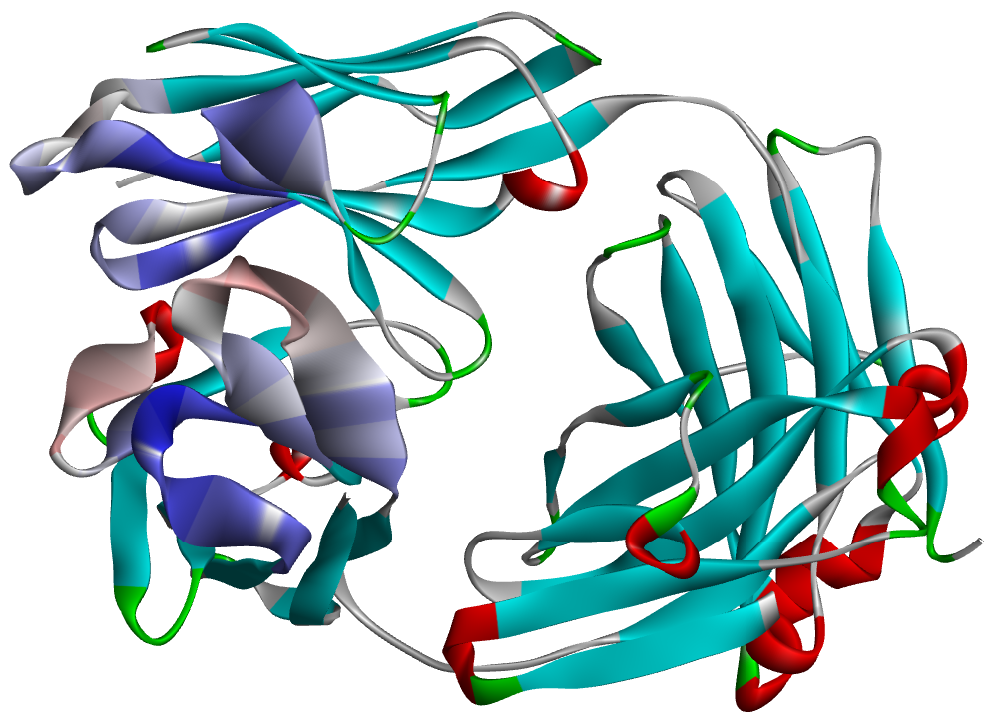
Agenda
Introduction to Antibodies
Introduction to Discovery Studio
Working with Antibodies
Fab Antibody Modeling
  Structure Template Identification
  Framework Model Generation
  Analysis & Selection of Framework Model(s)
  Loop Refinement (CDR)
  De Novo Loop Modeling (Optional)
  Additional Antibody Modeling
  Full Length Antibody Modeling
  Minimization
  Next Steps

Slide 4


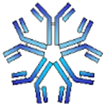
Antibodies as Drug Targets
An antibody, also known as an immunoglobulin (Ig), is a large Y-shaped protein produced by the immune system as a first line of defense against foreign entities
The quest for better therapeutic antibodies has gained great momentum in recent years, motivated by a convergence of clinical, scientific, technological and commercial factors
Why Build Antibody Models?
Relatively inexpensive method for deriving an antibody structure
Models can be quickly built and correlated to experimental observations
Models can be used to study biophysical properties of an antibody and help build new hypotheses
Models can guide experiments used for improving solubility, binding affinity, stability or any other structure based antibody work
Structural knowledge can inform approaches for humanization and reducing immunogenicity
Models can be used to help in the design of new antibody libraries
Chan AC, Carter PJ. Therapeutic antibodies for autoimmunity and inflammation. Nature Reviews Immunology. 2010, 10, 301
Beck A, Wurch T, Bailly C, Corvaia N. Strategies and challenges for the next generation of therapeutic antibodies. Nature Reviews Immunology. 2010, 10, 345.

Slide 5
Top 25 Drug Products in the World
 |  |  |  |  | WW Product Sales ($bn)
 | Product | Generic Name | Company | Pharmacological Class | 2010 | 2011 | % Growth | Age (Yrs) | Technology
1 | Lipitor | atorvastatin calcium | Pfizer + Astellas + Almirall | Statin/ HMG CoA reductase inhibitor | 11,967 | 10,840 | -9% | 15.3 | Chiral chemistry
2 | Plavix | clopidogrel bisulfate | BMS + Sanofi | Platelet aggregation inhibitor | 9,148 | 9,654 | 6% | 14.3 | Small molecule
3 | Humira | adalimumab | Abbott + Eisai | Anti-TNFa MAb6 | 6,742 | 8,236 | 22% | 9.4 | Antibody
4 | Seretide/Advair | fluticasone; salmeterol | GSK + Almirall + Faes | Beta 2 adrenoreceptor agonist & corticosteroid | 8,063 | 8,233 | 2% | 13.7 | Small molecule
5 | Enbrel | etanercept | Amgen + Pfizer + Takeda | TNFa inhibitor | 7,257 | 7,892 | 9% | 13.6 | Recombinant product
6 | Remicade | infliximab | J&J + Merck + Mitsubishi Tanabe | Anti-TNFa Mab | 6,520 | 7,187 | 10% | 13.8 | Antibody
7 | Crestor | rosuvastatin calcium | AstraZeneca + Shionogi + Chiesi | Statin/ HMG CoA reductase inhibitor | 6,106 | 7,161 | 17% | 9.3 | Small molecule
8 | Rituxan | rituximab | Roche + Biogen Idec | Anti-CD20 Mab | 6,113 | 6,790 | 11% | 14.5 | Antibody
9 | Seroquel | quetiapine fumarate | AstraZeneca + Astellas | 5-HT2 & dopamine D2 antagonist | 5,611 | 6,180 | 10% | 14.7 | Small molecule
10 | Avastin | bevacizumab | Roche | Anti-VEGF Mab | 6,214 | 5,984 | -4% | 8.3 | Antibody
11 | Singulair | montelukast sodium | Merck + Kyorin + Sigma-Tau | Leukotriene D4 antagonist | 5,410 | 5,967 | 10% | 14.3 | Small molecule
12 | Herceptin | trastuzumab | Roche | Anti-HER2 Mab | 5,221 | 5,940 | 14% | 13.7 | Antibody
13 | Diovan | valsartan | Novartis + Ipsen + Recordati | Angiotensin II antagonist | 6,134 | 5,737 | -6% | 15.7 | Small molecule
14 | Lantus | insulin glargine | Sanofi | Insulin | 4,658 | 5,451 | 17% | 11.9 | Recombinant product
15 | Abilify | aripiprazole | Otsuka + Bristol-Myers | 5-HT1A & D2 partial agonist & 5-HT2 antagonist | 4,593 | 5,216 | 14% | 9.5 | Small molecule
16 | Januvia/Janumet | sitagliptin phosphate | Merck + Ono + Almirall | DPP-IV inhibitor | 3,525 | 5,124 | 45% | 5.7 | Small molecule
17 | Gleevec | imatinib mesylate | Novartis | Tyrosine kinase inhibitor | 4,265 | 4,659 | 9% | 11 | Small molecule
18 | Zyprexa | olanzapine | Eli Lilly | Atypical anti-psychotic | 5,026 | 4,622 | -8% | 15.7 | Small molecule
19 | Nexium | esomeprazole magnesium | AstraZeneca + Daiichi Sankyo | Proton pump inhibitor | 4,969 | 4,478 | -10% | 11.8 | Chiral chemistry
20 | Spiriva | tiotropium bromide | Boehringer Ingelheim + Pfizer | Long-acting muscarinic antagonist | 3,799 | 4,389 | 16% | 10 | Small molecule
21 | Cymbalta | duloxetine hydrochloride | Eli Lilly + Shionogi | 5-HT & norepinephrine reuptake inhibitor | 3,491 | 4,245 | 22% | 7.8 | Small molecule
22 | Neulasta | pegfilgrastim | Amgen | Granulocyte colony-stimulating factor | 3,558 | 3,952 | 11% | 10.1 | Recombinant product
23 | Actos | pioglitazone hydrochloride | Takeda + Abbott | PPAR gamma agonist | 4,636 | 3,894 | -16% | 12.8 | Small molecule
24 | Lyrica | pregabalin | Pfizer + Eisai | Alpha 2 delta ligand | 3,096 | 3,836 | 24% | 7.7 | Small molecule
25 | Lucentis | ranibizumab | Novartis + Roche | Anti-VEGF Mab | 2,935 | 3,772 | 29% | 5.7 | Antibody
Biologics are therapies typically derived from living organisms or organic substances and include therapeutic proteins, DNA vaccines, monoclonal antibodies, and fusion proteins as well as new experimental modalities such as gene therapy, stem cell therapy, antisense nucleotides and RNA viruses
The % of sales from biologics within the world's top 100 drugs, is set to increase from 34% in 2011 to 49% by 2018
The total value of biologics sales is set to grow 51% between 2011 and 2018 from $142bn to $215bn
More than 25% of biologics in Phase II between 2006 and 2010 reached the market compared to about 10% of small molecules
12% of biologics were calculated to advance from preclinical to clinical studies, compared with just 2% of small molecule drugs
% candidates clearing each successive clinical review
KMR Group. Pharmaceutical Benchmarking Forum 2012
 | Phase I | Phase II | Phase III | Registration
Small molecules | 4 | 9 | 44 | 78
Biologics | 17 | 27 | 58 | 82
EvaluatePharma. World Preview 2018 Embracing the Patent Cliff

Slide 6
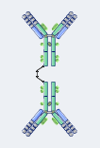
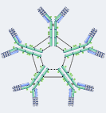
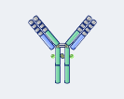

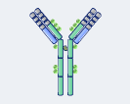
Antibody Types
There are five classes of antibodies - IgM, IgG, IgA, IgD, and IgE – each having a different function
 | IgG | IgA | IgM | IgD | IgE
% of serum antibodies | 80 | 13 | 6 | 1 | 0.002
Average serum half-life (days) | 23 | 6 | 5 | 3 | 2.5
Notes | Second antibody produced in a primary immune response to an antigen Involved in long-term immunity | Found in blood and mucosal secretions such as saliva, tears, and breast milk Provides protection against respiratory and gastrointestinal infections | First antibody produced in a primary immune response to an antigen | Serves as a membrane-bound receptor on the surface of B cells | Involved in inflammation and allergic responses Forms a receptor on the surface of basophils and mast cells that recognizes and binds to allergens
Structure | Monomer | Dimer, Monomer | Pentamer | Monomer | Monomer

Slide 7
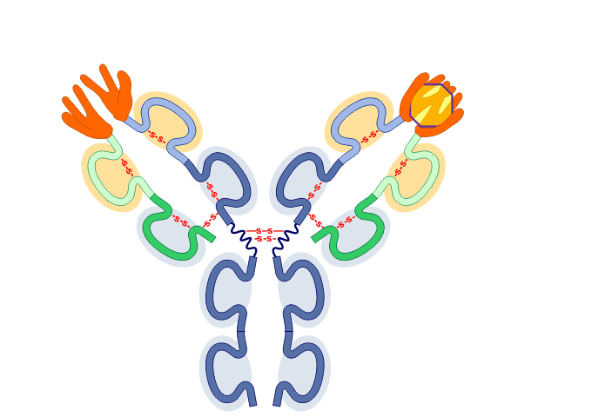
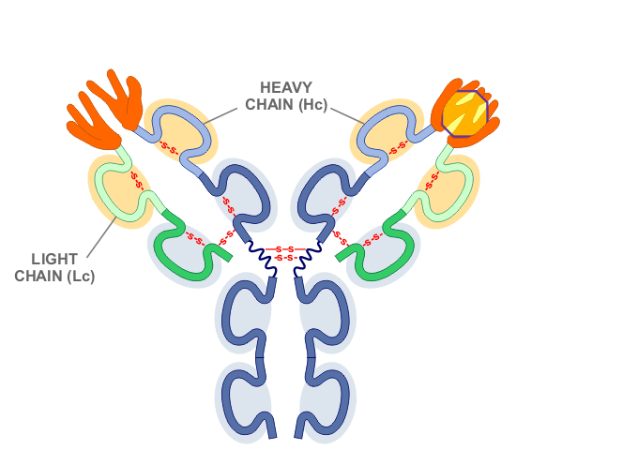
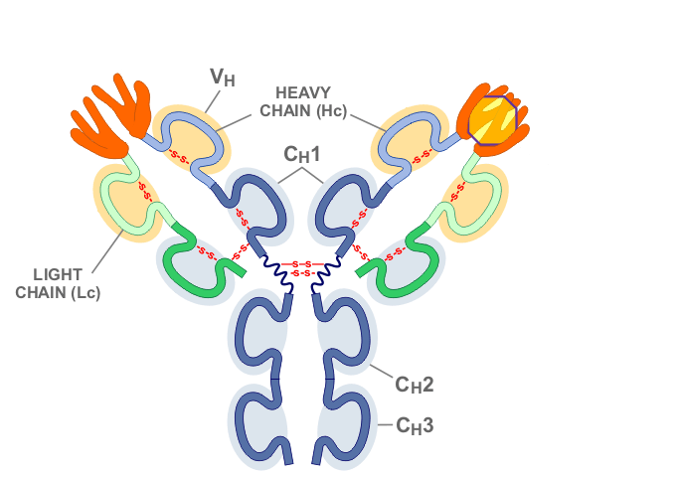

Antibody Structure
An antibody molecule consists of two identical heavy protein chains (blue and light blue) combined with two identical light chains (green and light green)
The heavy chains each consist of three constant domains (C_{H}1, C_{H}2, and C_{H}3) and one variable domain (V_{H})
The light chains each consist of a constant domain (C_{L}) and a variable domain (V_{L})

Slide 8
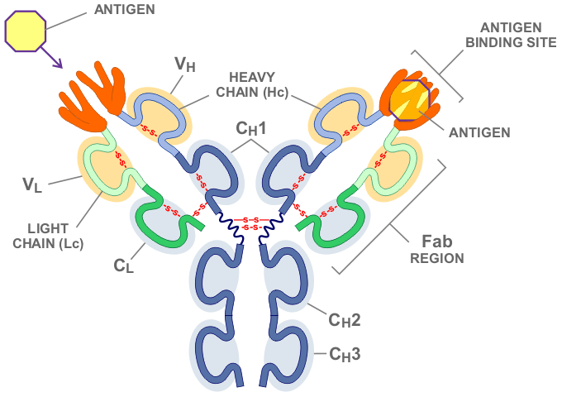
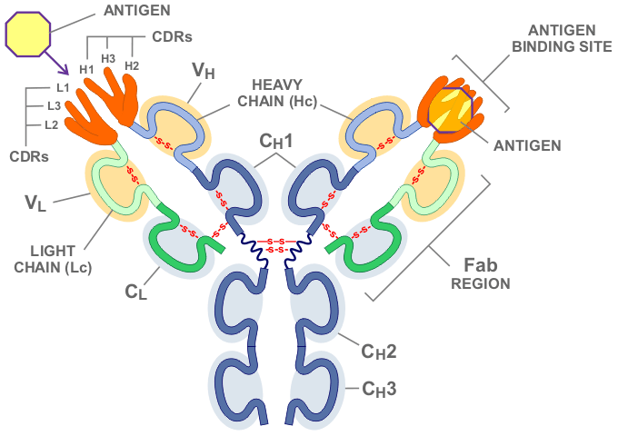
Antibody Structure
The specific size and shape of the CDRs determines to which antigens the antibody can and will bind
The variable domains contain the Complementary Determining Regions (CDRs) responsible for binding to the antigen
There are three CDR loops per variable domain (L1, L2, L3 on the light chains and H1, H2, H3 on the heavy chains)
The fragment antigen binding (Fab) region of an antibody binds the antigen and is composed of one constant and one variable domain from each heavy and light chain

Slide 9
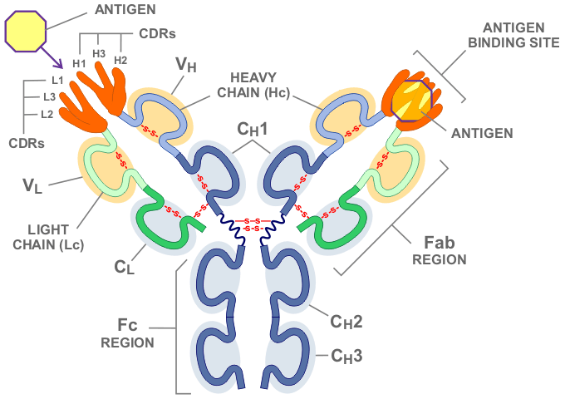
Antibody Structure
The Fc (Fragment crystallizable) region of the antibody is the part of the molecule which binds to receptors on the surface of cells like macrophages, neutrophils, and NK-cells, and plays a role in modulating immune cell activity

Slide 10





Obtaining Antibody Template Structures
Protein Data Bank
  URL http://www.rcsb.org/pdb
  Run by the Research Collaboratory for Structural Bioinformatics (RCSB)
Abysis Databases
  www.bioinf.org.uk
  Dr Andrew CR Martin's Group
IMGT – International ImMunoGeneTics information system®
  http://imgt.cines.fr/
Web Antibody Modeling
  http://antibody.bath.ac.uk/abmod.html
Prediction of ImmunoGlobulin Structure
  http://arianna.bio.uniroma1.it/pigs/

Slide 11
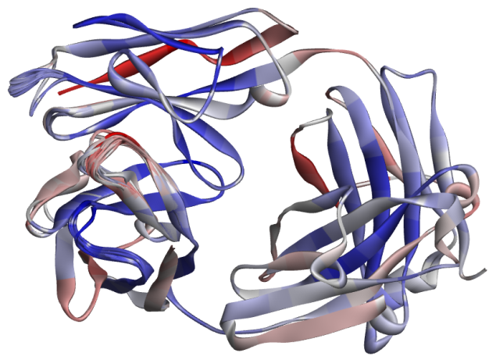
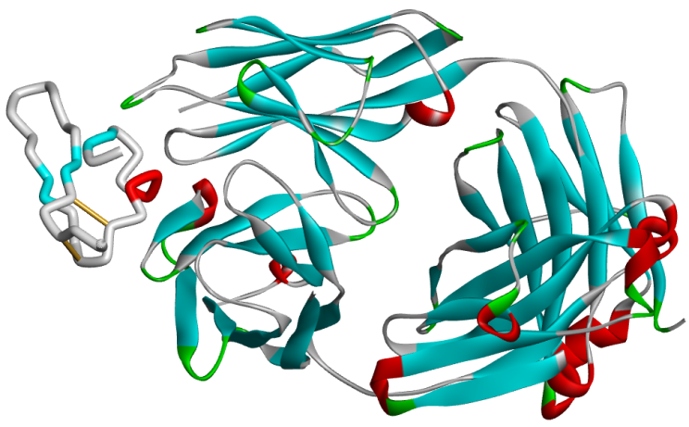
Fab Antibody Modeling Workflow
Annotate Antibody Sequence
Identify Antibody Framework
Find template(s) for framework
Model Antibody Framework
Generate pre-model
Model Antibody Loops
Knowledge/Template based
Loop Refinement
De novo loop generation
Final Refinement
Protein-Protein Docking
Interaction Analysis

Slide 12
Agenda
Introduction to Antibodies
Introduction to Discovery Studio
Fab Antibody Modeling
  Structure Template Identification
  Framework Model Generation
  Analysis & Selection of Framework Model(s)
  Loop Refinement (CDR)
  De Novo Loop Modeling (Optional)
  Additional Antibody Modeling
  Full Length Antibody Modeling
  Minimization
  Next Steps

Slide 13
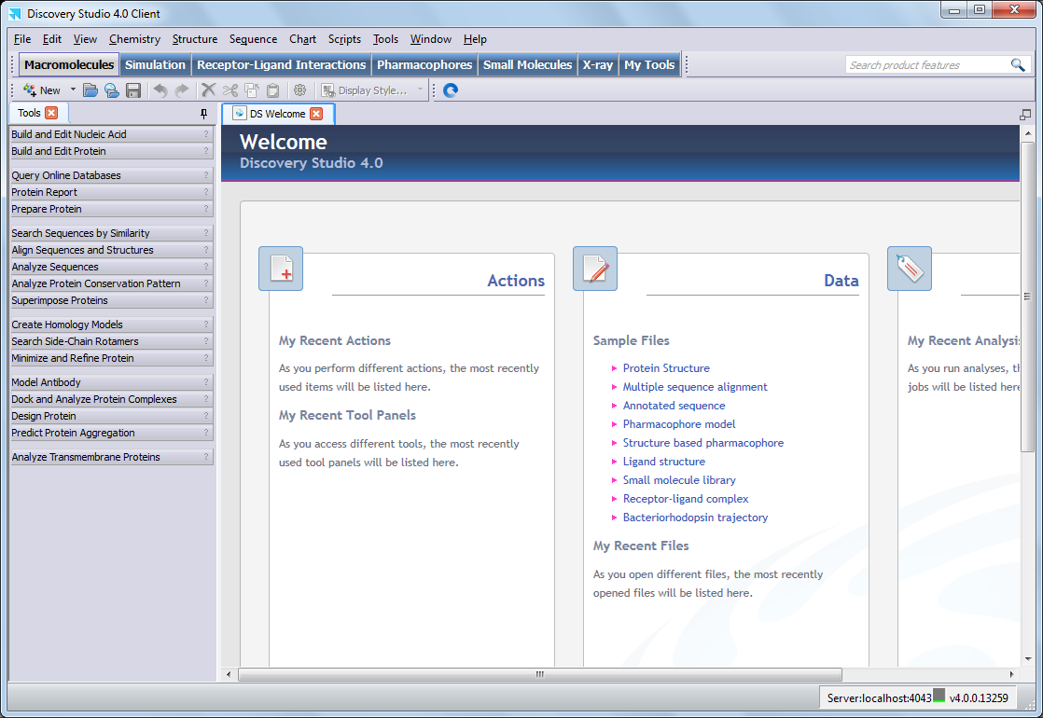
Discovery Studio - User Interface
Menus
Tool Sets
Toolbars
Feature Search
Tools Explorer
Welcome Page
&
Molecule Windows

Slide 14
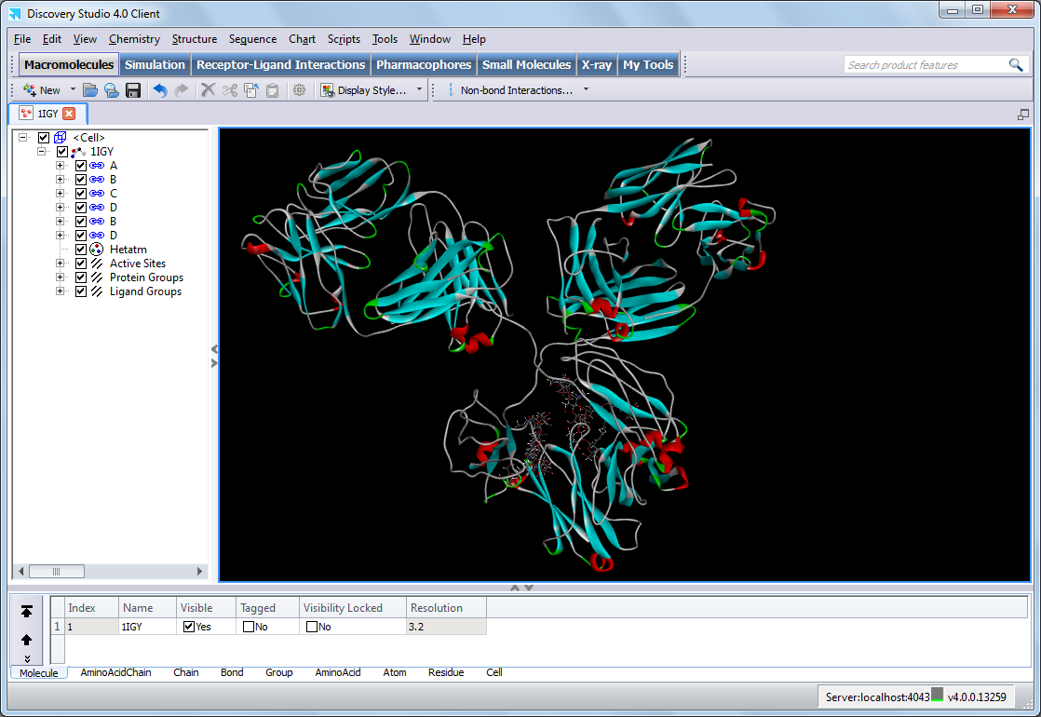
Molecule Window
The Molecule Window provides different ways of viewing and manipulating molecular data:
Graphics View
  Displays the 3-dimensional structure of molecular objects
Hierarchy View
  Shows the hierarchical relationships between different objects
Data Table View
  Displays molecular properties in a table
Hierarchy View
Click on the arrows to hide/view the Hierarchy and Table View
Graphics View
Data Table View

Slide 15
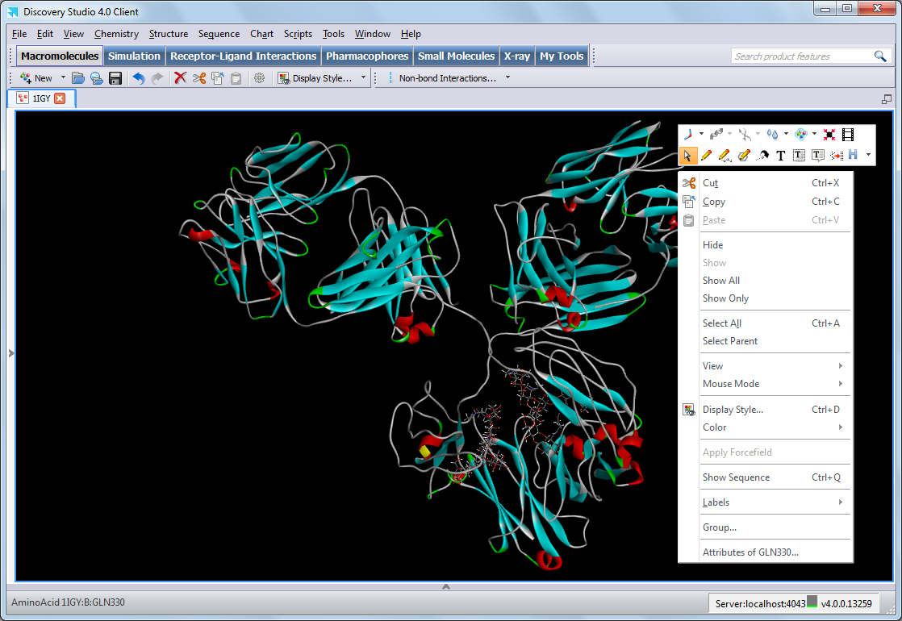
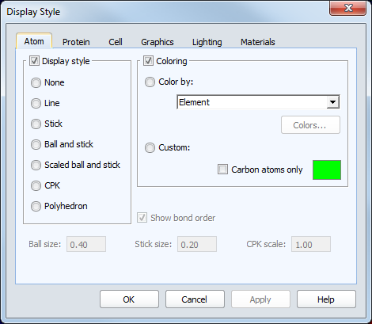
Molecule Window - Graphics Display Style
Change the style of structural displays in the Molecule Window
Display Style on Standard toolbar or Right-mouse click in Graphics View
Display Style on Standard toolbar or right-mouse click in Graphics View
Selections in Graphics View noted
Right-mouse click in Molecule Window to display context menu toolbars for fast access to commonly used commands
Selections in Graphics View noted

Slide 16
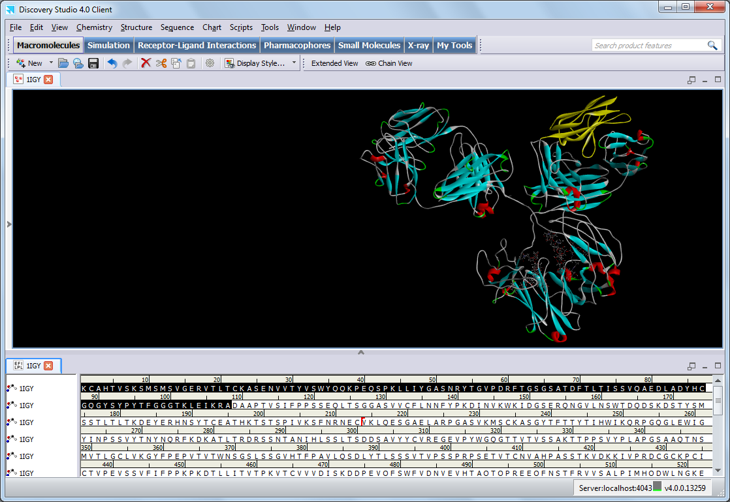
Sequence Window
The Sequence Window allows you to view and edit molecular sequences and sequence alignments
File | Open… for a sequence or sequence alignment file
File | New | Sequence Window to open an empty Sequence Window
Load a protein and then use Sequence | Show Sequence command menu or CTRL+Q
The sequence-structure link can be established using the Sequence | Link Sequence and Structure… command
Selections in the Sequence Window View are also highlighted in the Graphics, Hierarchy and Data Table View (and vice versa)

Slide 17
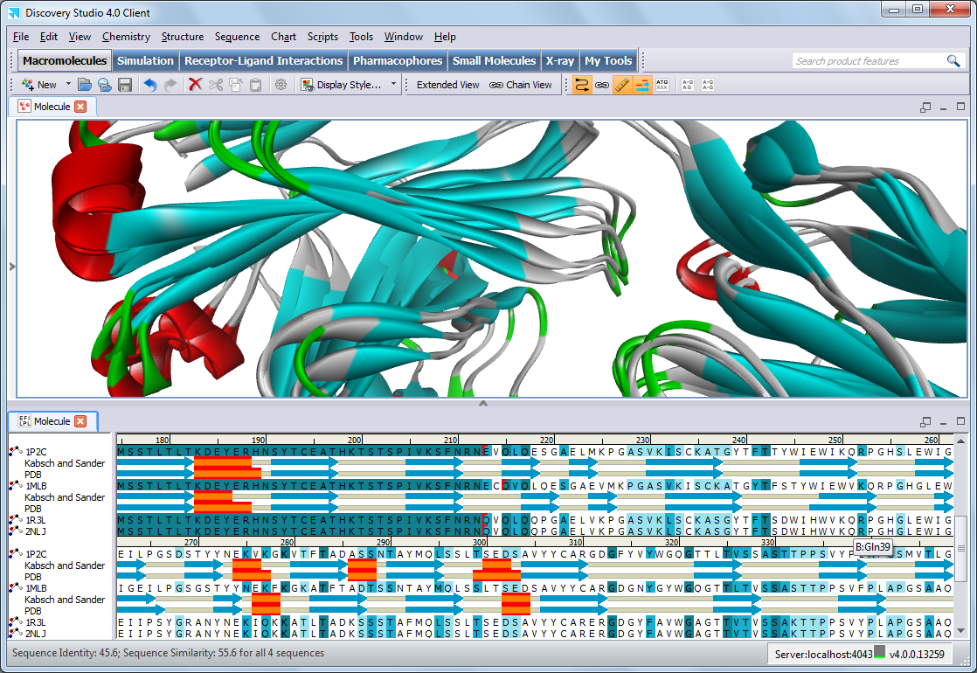
Sequence Window
Sequences can be edited:
Insert (Space bar)
Delete (Delete or Backspace)
Sequence and Smart toolbars
The sequence is linked to a 3D structure
The sequence-structure link is broken
For multiple sequences, percentage sequence identity and similarity are shown in Status Bar
Display the secondary structure cartoon
Chain break
Hovering over a specific residue shows the residue ID

Slide 18
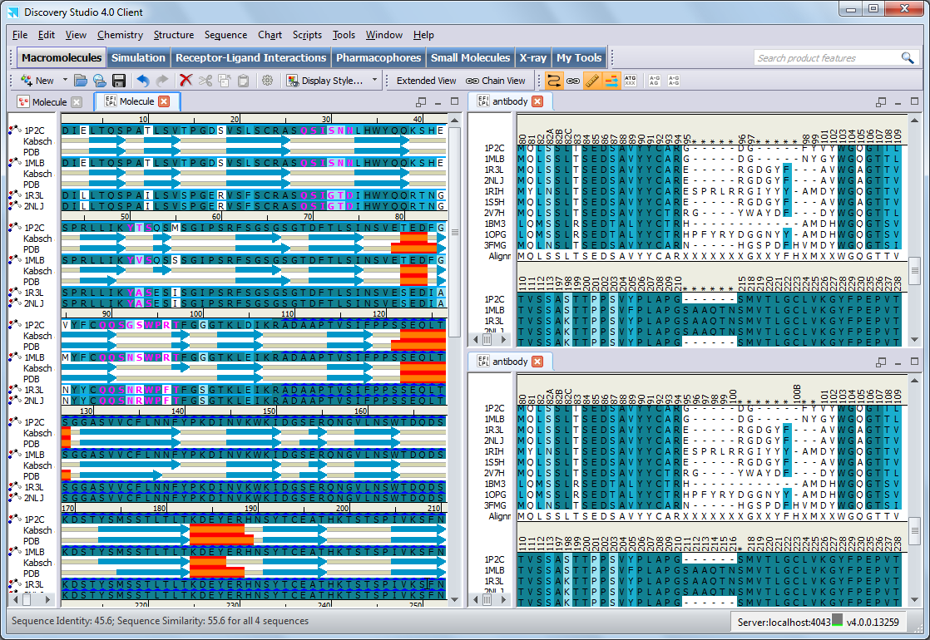
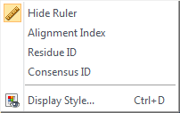
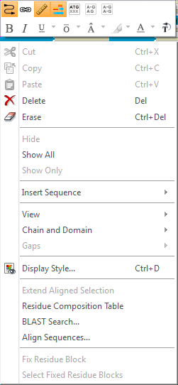
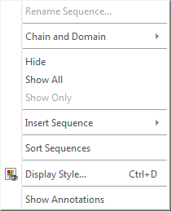
Sequence Window
Three ruler numbering options:
Alignment index
Residue ID
Consensus ID
Right-mouse click ruler for context menu
Right-mouse click sequence for context menu to provide easy access to tools from the Sequence and Font toolbars
Right-mouse click sequence name for context menu
Displays the residue ID (number and insertion code) of the first sequence in the ruler. A gap in the first sequence is indicated by an asterisk (*)
Displays the residue ID (number and insertion code) of the first sequence in the ruler. A gap in the first sequence is indicated by an asterisk (*)
Consensus residue ID of each column where non-gap residue identifiers match. An asterisk is displayed if:
An alignment column consists of all gaps
One or more non-gap residue identifiers do not match

Slide 19
Agenda
Introduction to Antibodies
Introduction to Discovery Studio
Working with Antibodies
Fab Antibody Modeling
  Structure Template Identification
  Framework Model Generation
  Analysis & Selection of Framework Model(s)
  Loop Refinement (CDR)
  De Novo Loop Modeling (Optional)
  Additional Antibody Modeling
  Full Length Antibody Modeling
  Minimization
  Next Steps

Slide 20
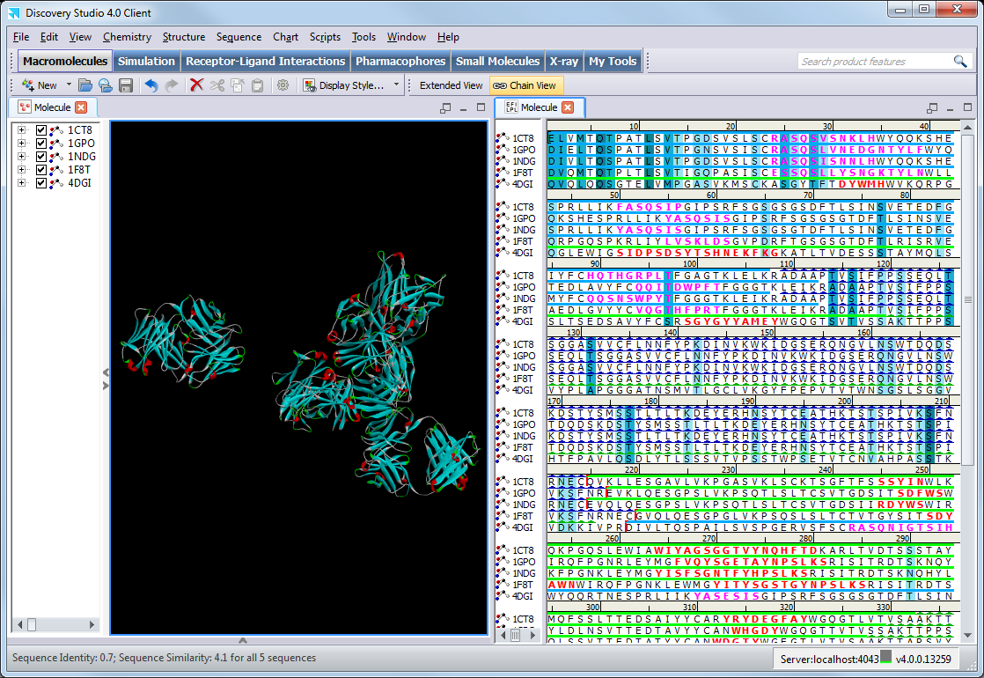
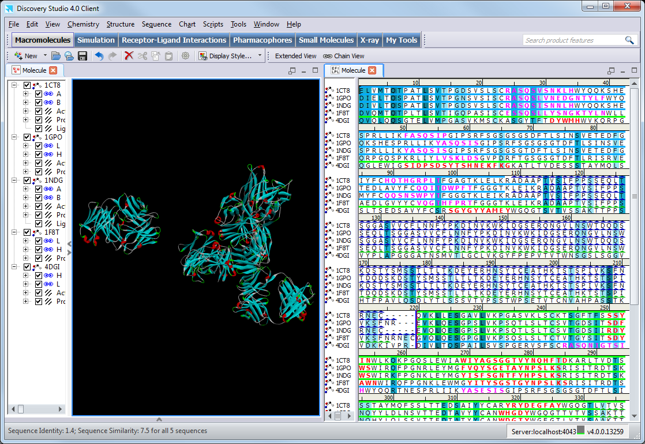
Working with Antibodies – Chain Order
The antibody sequences and structure that you are working with may be inconsistently ordered and not aligned, making them more difficult to work with and compare
4 of these sequences are in the order of light/heavy and one (4DGI) is in the order heavy/light
Tip: Annotate the antibody sequences first to see light and heavy chain sequences (details on Annotate Antibody Sequences protocol to come)
Select Chain View (Smart Tools or Sequence toolbar)

Slide 21
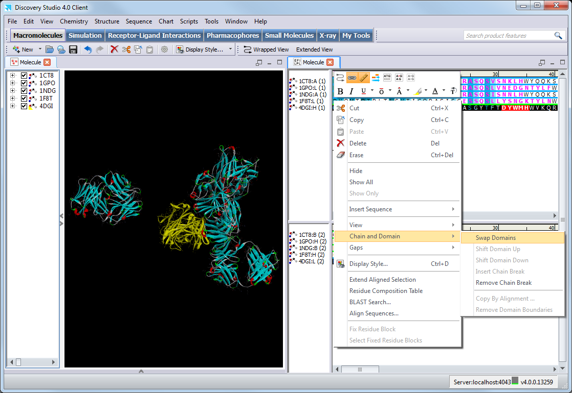
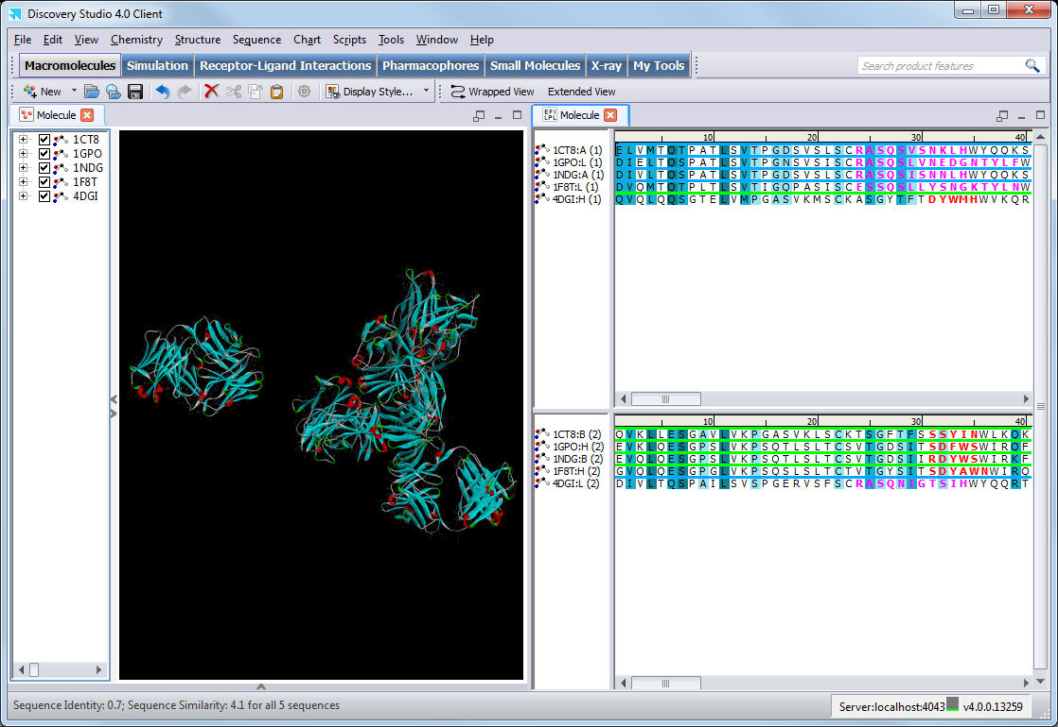
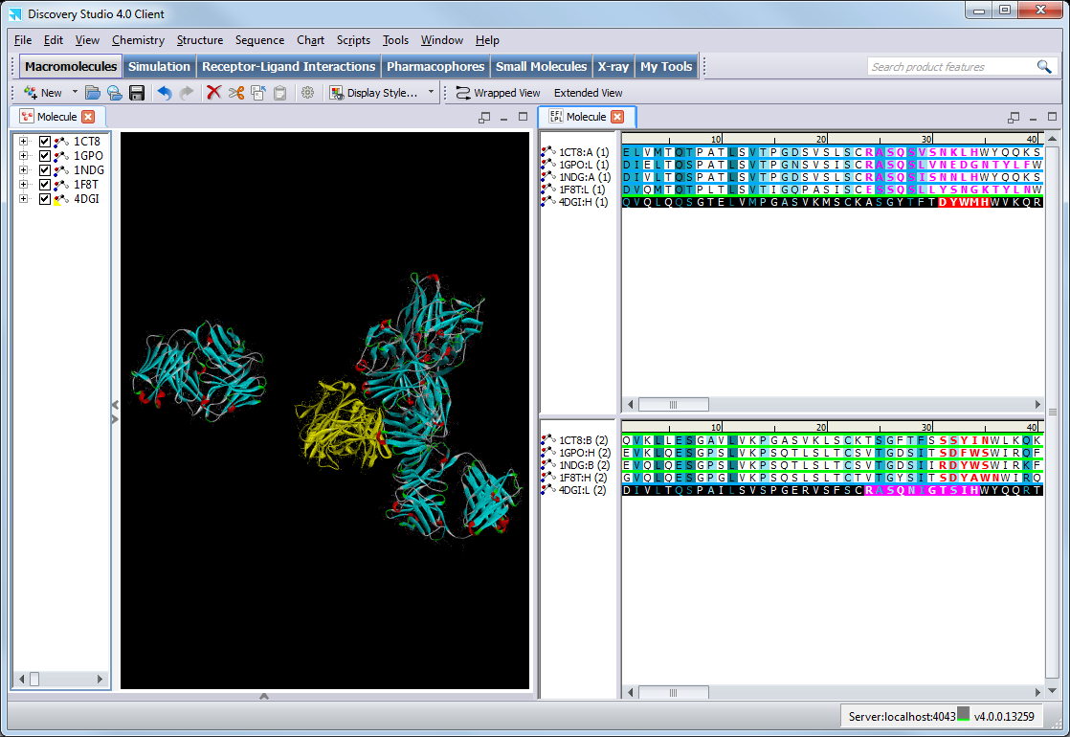
Working with Antibodies – Chain Order
CTRL+select 4DGI:H (1) and 4DGI:L (2) sequences
Right-mouse click and select Chain and Domain | Swap Domains

Slide 22
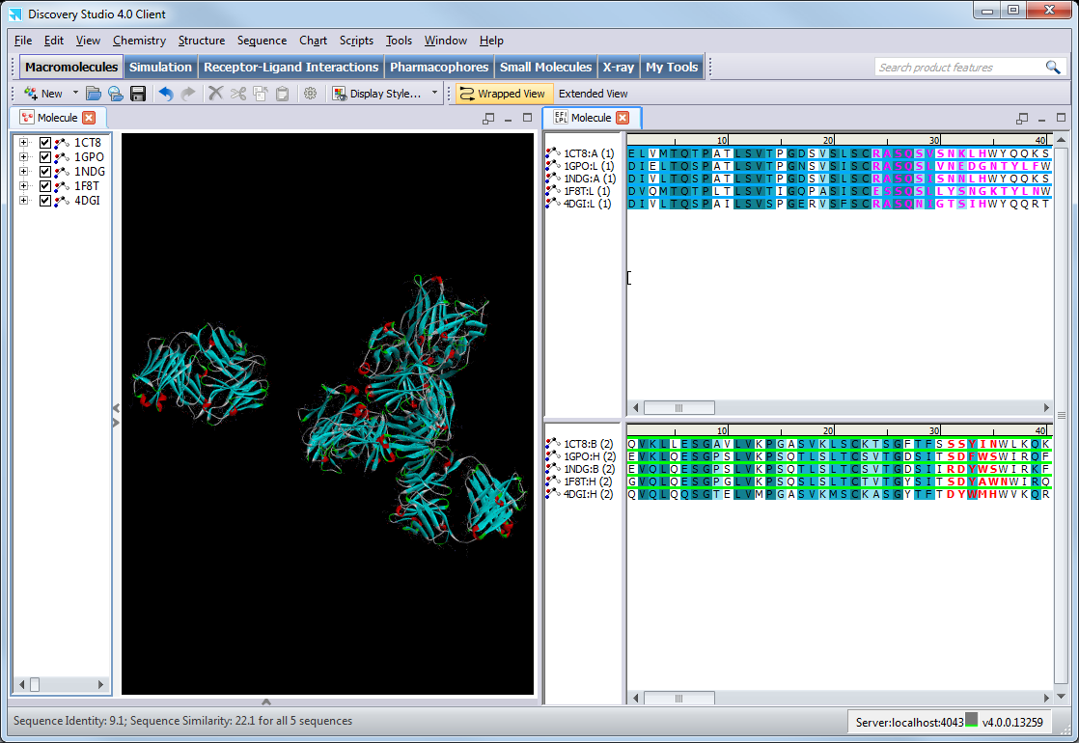
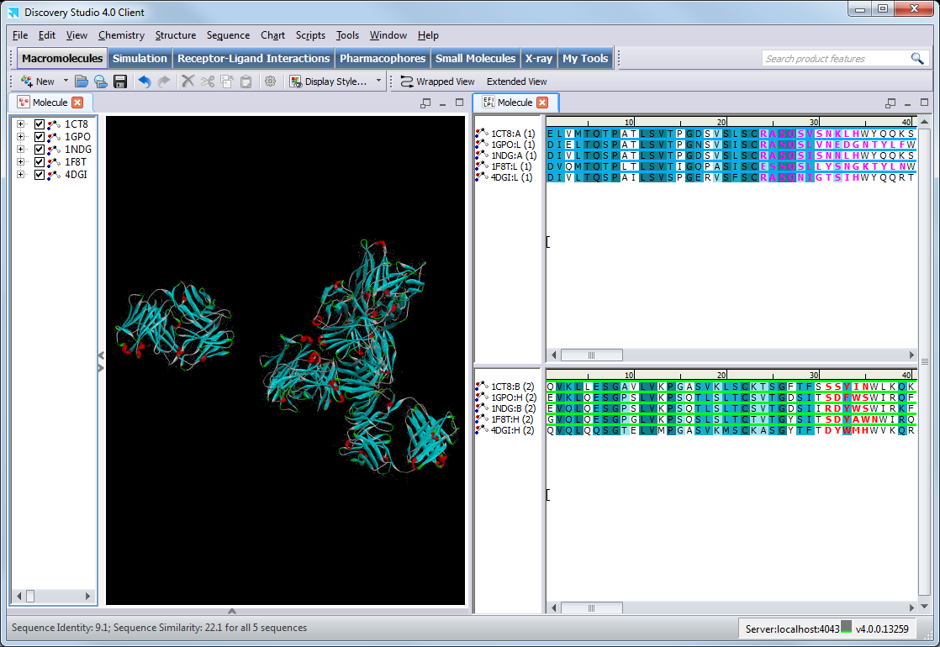
Working with Antibodies – Chain Order
Select Wrapped View to return to usual sequence view
The sequences can now be aligned by the residue identifiers, before aligning the structures by sequence alignment

Slide 23
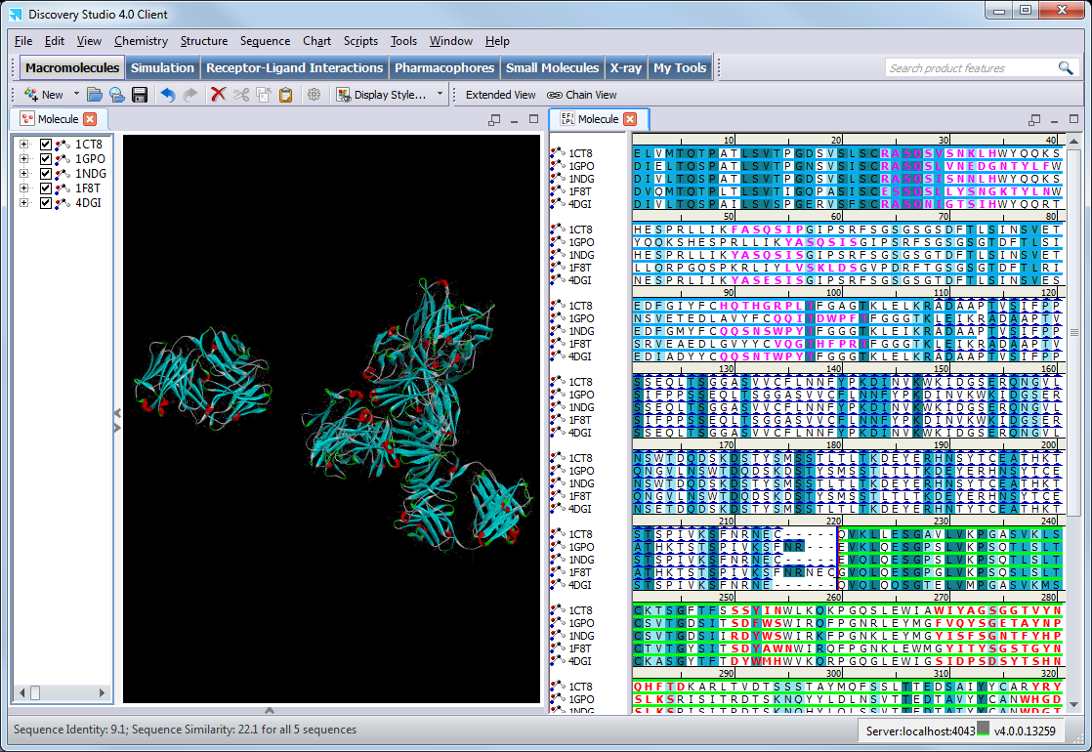
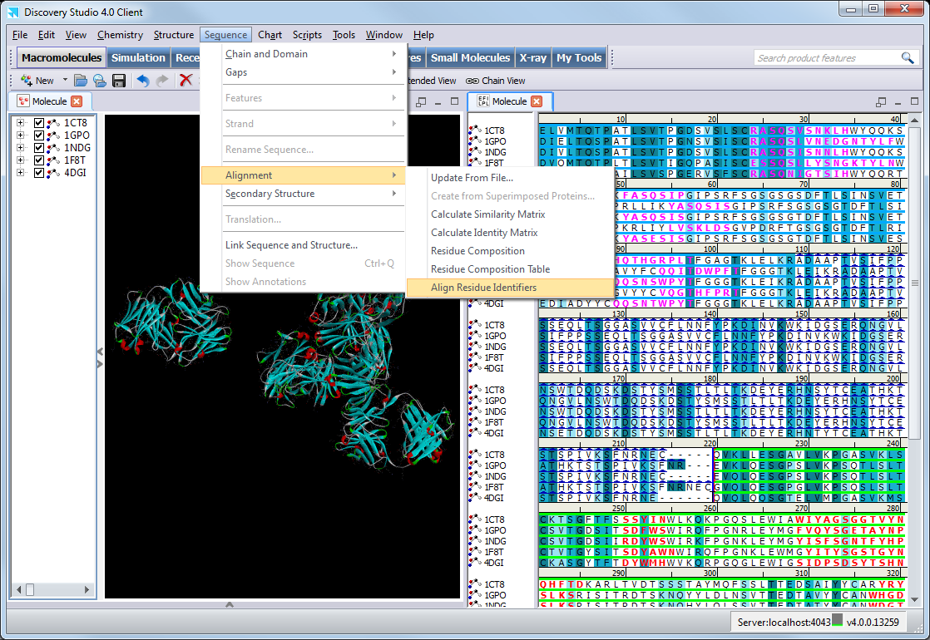
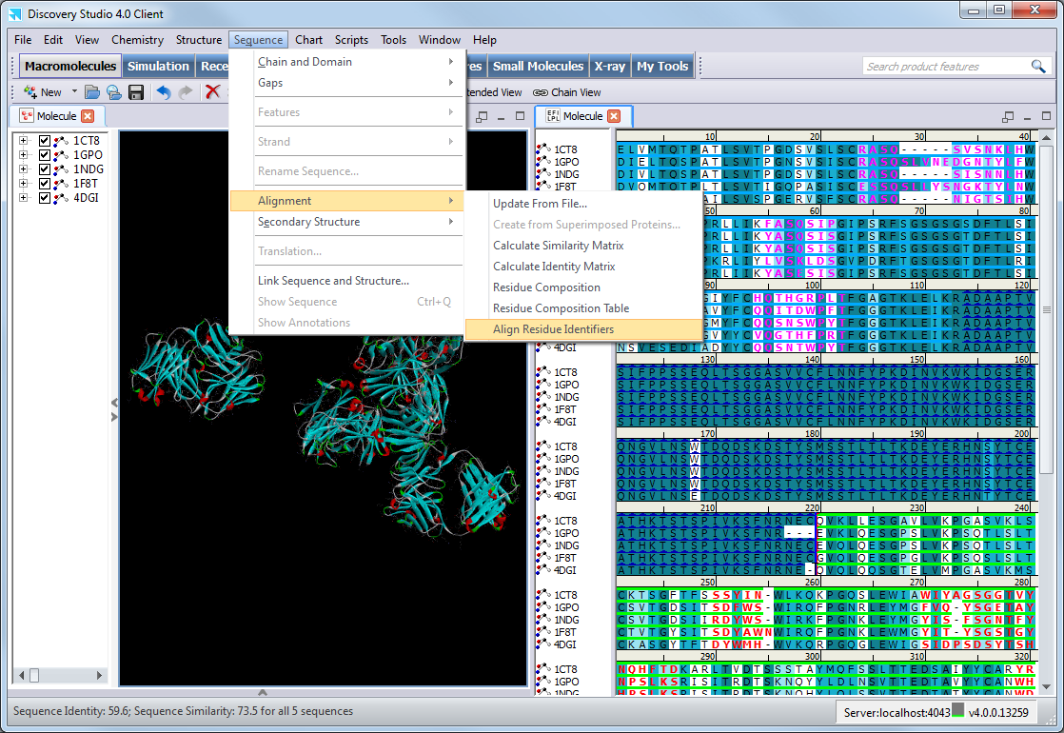
Working with Antibodies – Alignment
Select Sequence | Alignment | Align Residue Identifiers
The structures can now be aligned by the sequence alignment (Superimpose Proteins tool panel)

Slide 24
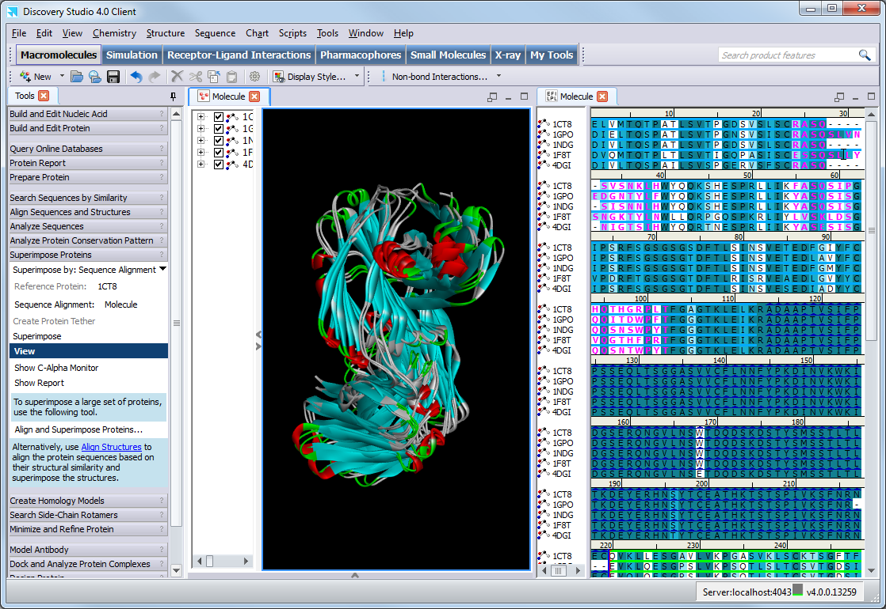
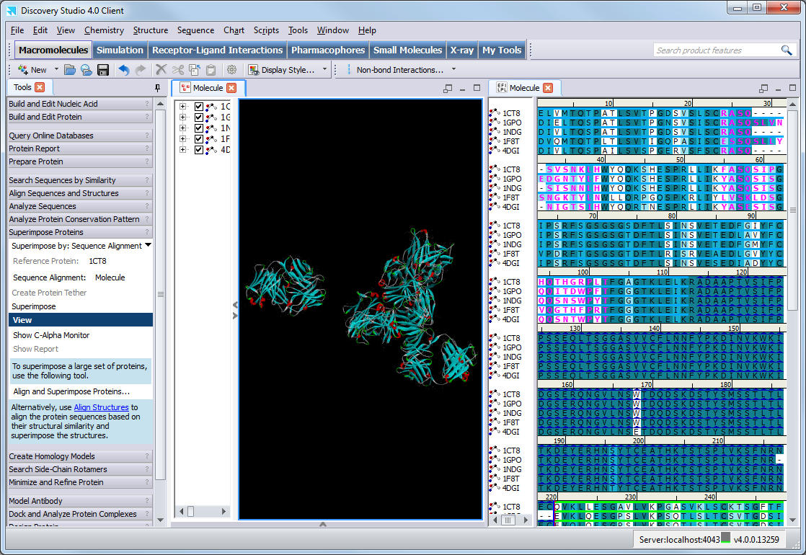
Working with Antibodies – Alignment
Select Superimpose from the Superimpose Proteins tool panel

Slide 25
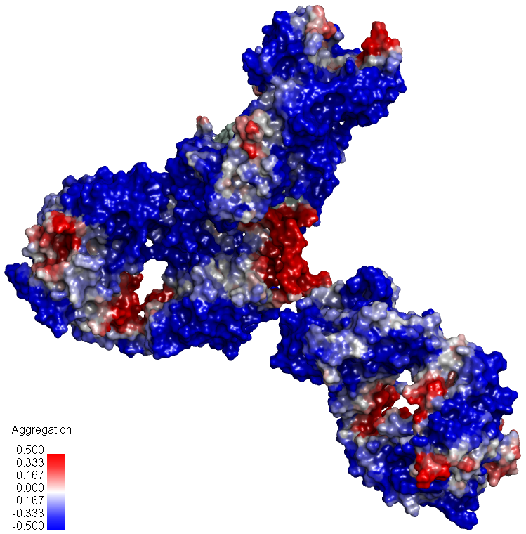
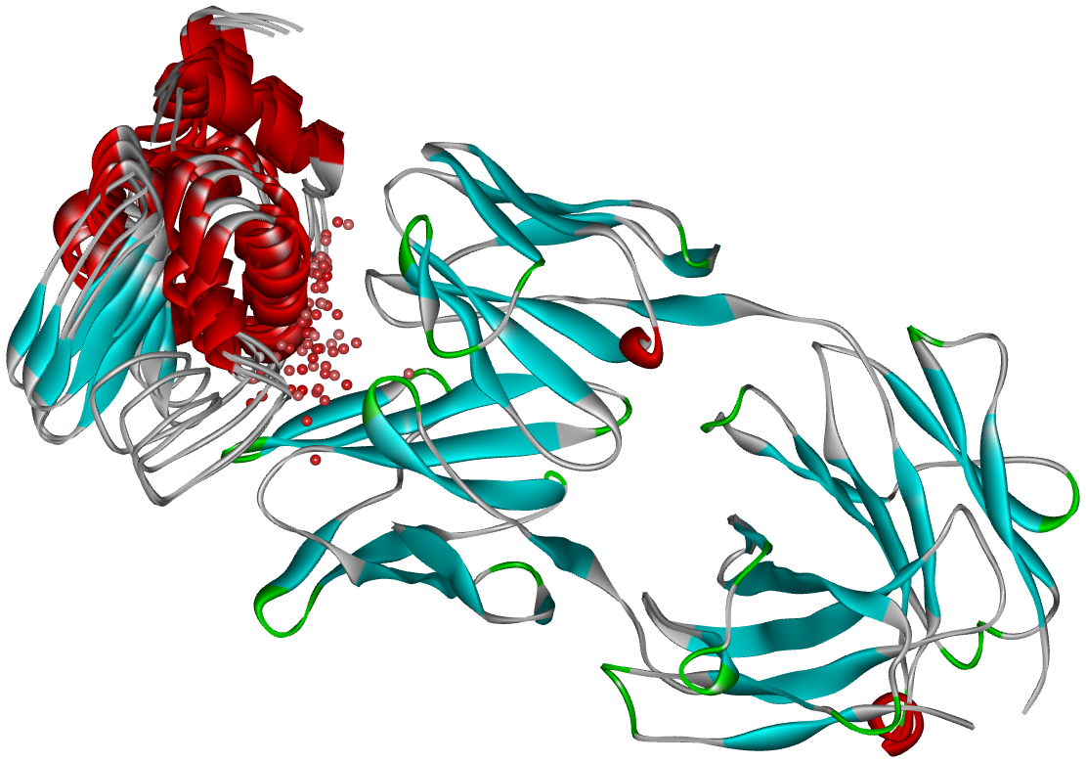
Antibody Modeling in Discovery Studio
The level of inspection and refinement recommended during the antibody model building process will depend on the requirements of the model and your objectives:
Quick and reliable structural models
  For mutation and humanization studies
  For calculating structural properties such as solvent accessibility, electrostatic potential, and aggregation hot spots
More accurate refined models
  For antigen-antibody docking studies
  For maturation studies

Slide 26
Agenda
Introduction to Antibodies
Introduction to Discovery Studio
Working with Antibodies
Fab Antibody Modeling
  Structure Template Identification
  Framework Model Generation
  Analysis & Selection of Framework Model(s)
  Loop Refinement (CDR)
  De Novo Loop Modeling (Optional)
  Additional Antibody Modeling
  Full Length Antibody Modeling
  Minimization
  Next Steps

Slide 27
Fab Antibody Modeling Workflow
Structure Template Identification
(Antibodies, Fv, Fab, IgG)
Annotate Antibody Sequence
Identify Framework Templates
There are two common methods for Antibody Framework modeling:
Chimeric Method
or
Single Template Method
2. Framework Model Generation
Model Antibody Framework from templates
3. Analysis & Selection of Framework Model(s)
  Evaluate quality of templates
When crystallographic structures exist that are similar in sequence and environment this information is used to generate refined loop conformations
4. Loop Refinement (CDR)
Model Antibody Loops
5. De Novo Loop Modeling (Optional)
Loop Refinement
When no sufficiently similar structural examples exist de novo generation is recommended

Slide 28
Fab Antibody Modeling Workflow
Structure Template Identification
(Antibodies, Fv, Fab, IgG)
Annotate Antibody Sequence
Identify Framework Templates
Load the Target Sequence
Annotate Antibody Sequence
Analyze Antibody Annotation
Identify Framework Templates
2. Framework Model Generation
Model Antibody Framework from templates
3. Analysis & Selection of Framework Model(s)
  Evaluate quality of templates
4. Loop Refinement (CDR)
Model Antibody Loops
5. De Novo Loop Modeling (Optional)
Loop Refinement

Slide 29
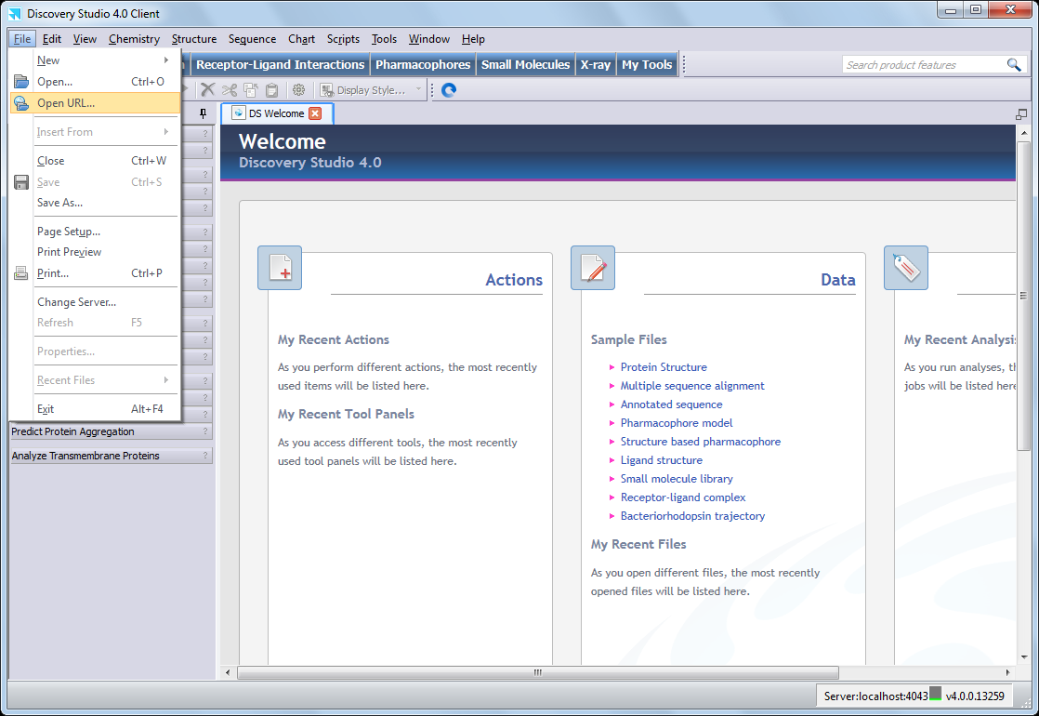
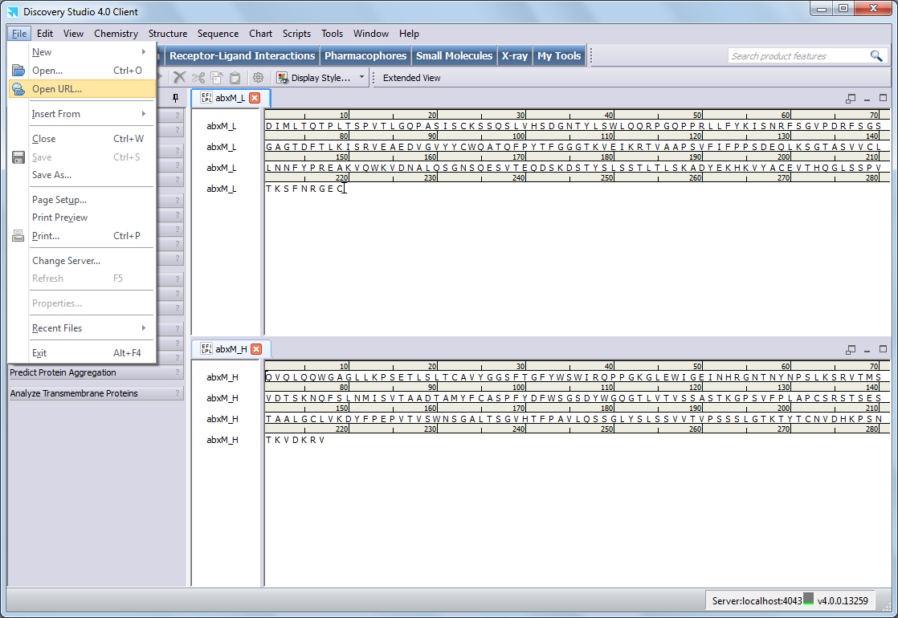
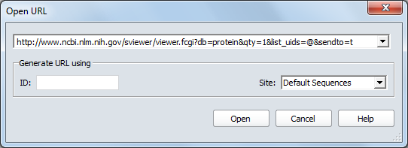
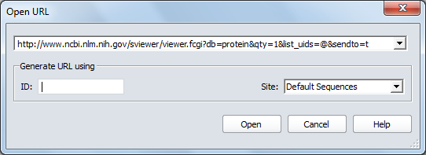
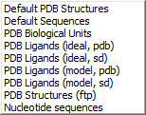
1. Structure Template Identification
A. Load the Target Sequence
Use the sequence identifier with File | Open URL… to load from the NCBI sequence database, or File | Open… to load from a file already on your network
Copy and paste into a new sequence window
Supported sequence file formats:
  Bioinformatic Sequence Markup Language (.bsml) (default)
  Biosym format (.seq)
  Pearson (FASTA) format (.fasta)
  NBRF-PIR format (.pir)
  Swiss-Prot format (.sws)
  GenBank (.gb)
  ClustalW (.aln)
  Biosym Alignment (.align)
  Clustal (.aln)
  GDE (.gde)
  GCG format (.ssf and .rsf)
  GCG multiple sequence (.msf)
For antibody modeling you will need a separate Light chain sequence and Heavy chain sequence
If your sequence is in a single file, cut-and-paste one sequence into a new Sequence Window
Tip: Name each Sequence Window to easily keep track of the light and heavy sequences

Slide 30
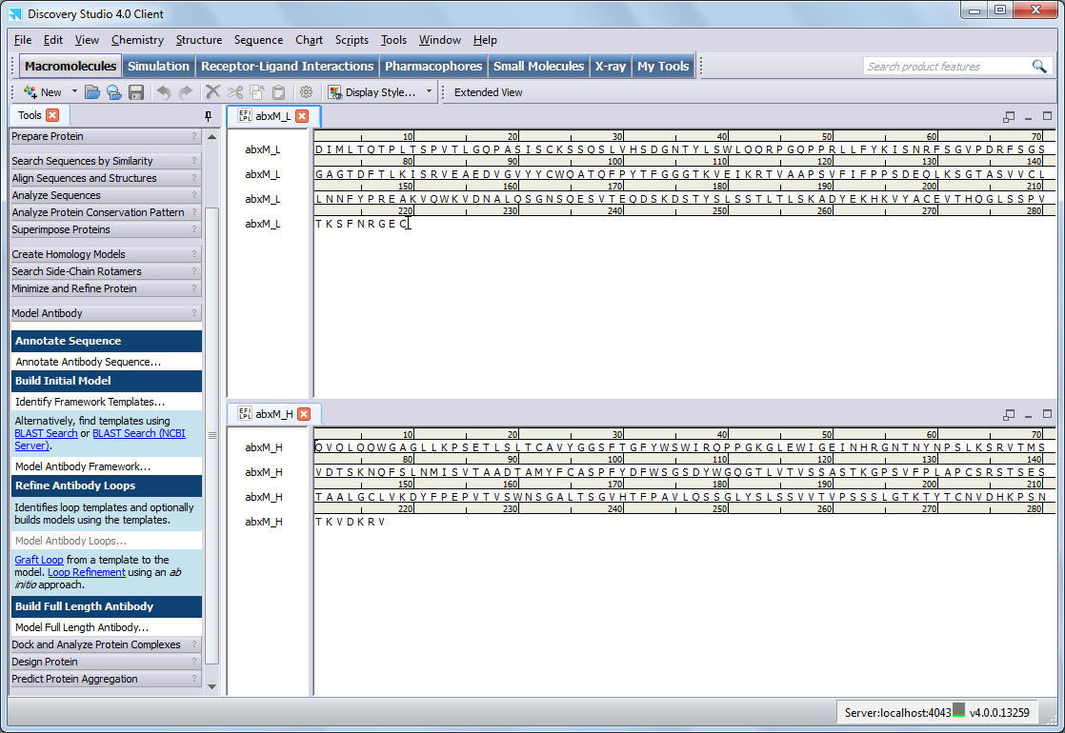
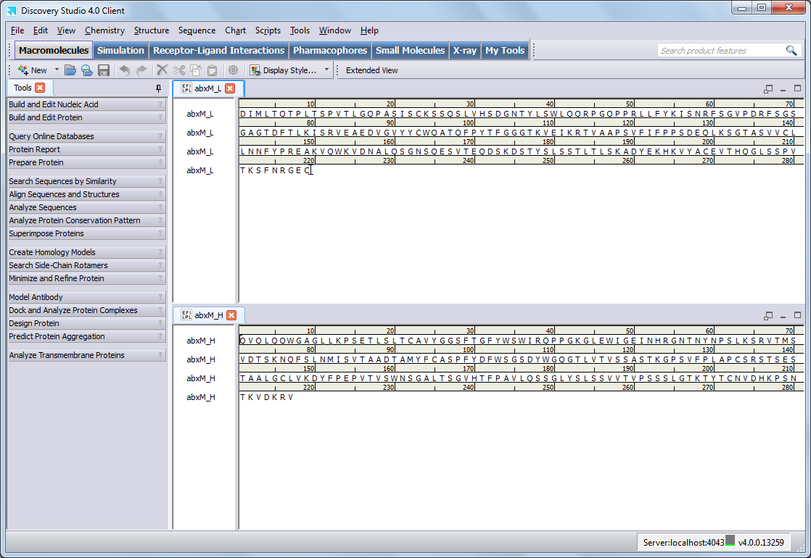
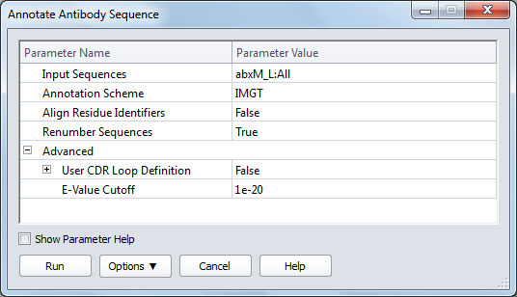

1. Structure Template Identification
B. Annotate Antibody Sequence
Annotation of an antibody sequence identifies the heavy and light chains, constant domains, variable domains and the CDRs in each
Uses HMM method for rapid accurate assignment
Advanced option includes customization of CDR assignments
Allows renumbering of residues and alignment of multiple sequences
The alignment option should not be used if the input sequences contain different domains to each other
Notes:
Residues in variable domains are renumbered according to one of the following commonly used annotation schemes from the antibody literature:
IMGT ([LeFranc et al., 2003] and [LeFranc, 1999])
[Lefranc, 2003] Lefranc, M.-P., Pommié, C., Ruiz, M., Giudicelli, V., Foulquier, E., Truong, L., Thouvenin-Contet, V. and Lefranc, G. IMGT unique numbering for immunoglobulin and T cell receptor variable domains and Ig superfamily V-like domains Dev. Comp. Immunol., 2003,27, 55-77
Chothia ([Al-Lazikani et al, 1997], [Morea et al., 2000], and [Chothia and Lesk, 1987])
Veronica Morea, V.; Tramontano, A.; Rustici,M., Chothia, C.; Lesk, A.M. Conformations of the Third Hypervariable Region in the VH Domain of Immunoglobulins J. Mol. Biol. 1998 275, 269-294
Kabat ([Kabat et al., 1991])
Kabat, E. A.; Wu, T. T.; Perry, H. M.; Gottesman, K. S.; Foeller, C.; Sequences of Proteins of Immunological Interest. U.S. Department of Health and Human Services, NIH, Bethesda, MD., 1991.
Honegger ([Honegger and Plückthun, 2001])
Honegger, A; Plückthun Yet Another Numbering Scheme for Immunoglobulin Variable Domains: An Automatic Modeling and Analysis Tool J. Mol. Biol. 309, 657-670 2001.
Additionally, the protocol identifies the CDR loop regions consistent with the selected annotation scheme as defined in the above cited literature. The CDR regions are determined based on the alignment of the input sequence to the precomputed Hidden Markov Models for which the range of the CDR loop regions is known.

Slide 31
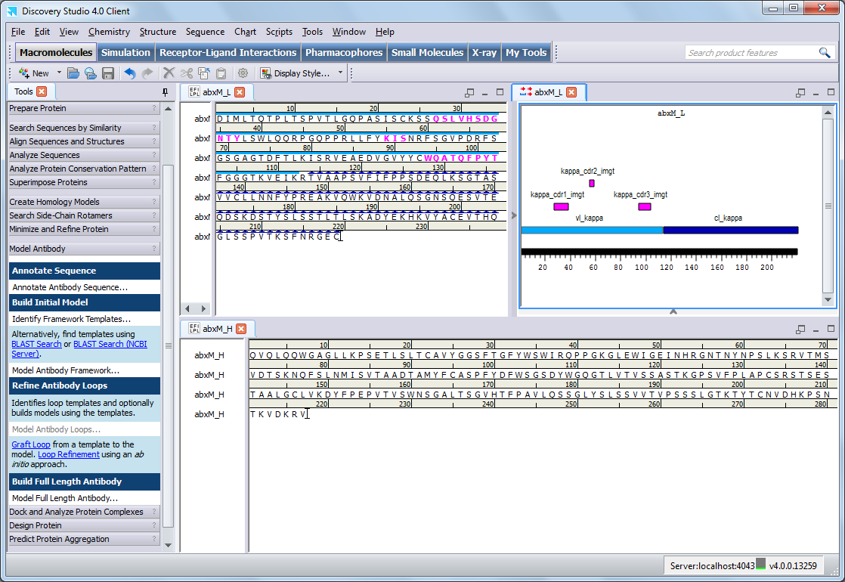
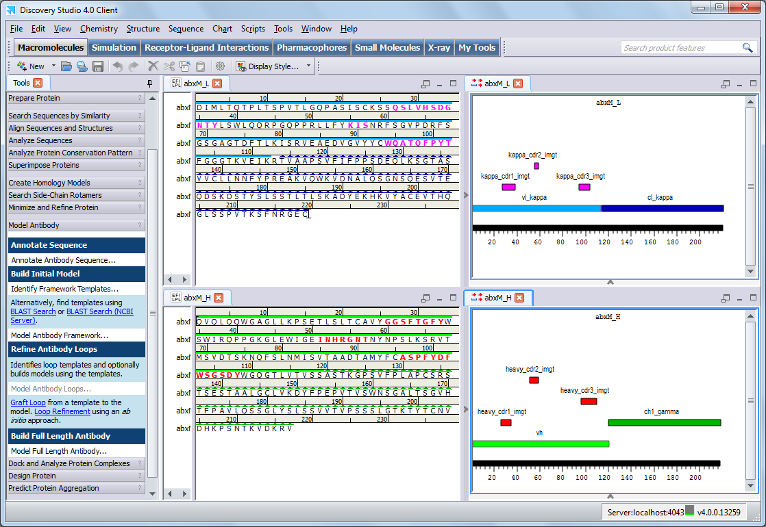

1. Structure Template Identification
C. Analyze Antibody Annotation
IMGT is the reference used by Discovery Studio
The other supported methods (Chothia, Kabat, Honegger) are defined relative to it
CDR assignments are customizable using the User CDR Loop Definition parameters

Slide 32

1. Structure Template Identification
Sequence Window annotation colors and patterns
CDR Loops are highlighted
light chain variable domains - bold pink
heavy chain variable domains - bold red
Domain Name | Domain Type | Sequence Window | Annotation Window
VL_Kappa | variable light chain, kappa
VL_Lambda | variable light chain, lambda
VH | variable heavy chain
CL_Kappa | constant light chain, kappa
CL_Lambda | constant light chain, lambda
CH1_ALPHA | constant heavy chain CH1, alpha
CH1_GAMMA | constant heavy chain CH1, gamma
CH1_MU | constant heavy chain CH1, mu
CH2_ALPHA | constant heavy chain CH2, alpha
CH2_EPSILON | constant heavy chain CH2, epsilon
CH2_GAMMA | constant heavy chain CH2, gamma
CH3_ALPHA | constant heavy chain CH3, alpha
CH3_EPSILON | constant heavy chain CH3, epsilon
CH3_GAMMA | constant heavy chain CH3, gamma
CH4_EPSILON | constant heavy chain CH4, epsilon

Slide 33

1. Structure Template Identification
D. Identify Framework Templates
Discovery Studio provides a specialized protocol for Framework Template Identification
This one protocol will identify the best template in the existing database for the Light chain, Heavy chain, and combined Light and Heavy chains
The CDRs can be excluded from the sequence similarity calculation used to rank the templates
The Light and Heavy chains must be separate sequences, but can be in the same window or different windows

Slide 34


1. Structure Template Identification
The Identify Framework Templates (and Model Antibody Loops) protocol make use of a pre-compiled Antibody Database that is installed with Discovery Studio by default
This database consists of non-redundant antibody sequences and structures that have been extracted from the RCSB Protein Data Bank (PDB) and processed according to their domains
The antibody database installed by default by the Discovery Studio installer only contains the non-redundant antibody structures
This can lead to situations when the hits found by this protocol are not contained in the installed structure database (e.g., when filtering by organism)
It is therefore recommended that you install the redundant template database before using this protocol
The antibody database can be updated with your own structures (DS Application Edition)

Slide 35
1. Structure Template Identification
i
The Antibody Database is generated from identified antibody structures in the RCSB Protein Data Bank:
From these structures, the antibody regions (Fab, Fv, VL, CL, etc.) are extracted, the light and heavy chain pairs are identified and ligands and water molecules are removed
The structures of the extracted regions are superimposed onto a reference structure for each domain type
The sequences are clustered and the sequence with the best corresponding X-ray resolution structure in each cluster is kept as the non-redundant representative
Non-redundant sequences are aligned respectively based on the four numbering schemes
An example Update Antibody Database protocol is provided to add new structures to the database:
The protocol can search the RCSB Protein Data Bank or locally stored PDB structures to find antibodies that are not yet in the database
These new antibodies are processed using the above workflow to be made available to use by the Identify Framework Templates and Model Antibody Loop protocols
The example protocol can be run from the Pipeline Pilot client or can be imported to be run from the Discovery Studio client
The antibody database files are located in the public/DS/Antibody folder of the server installation

Slide 36



1. Structure Template Identification
D. Identify Framework Templates
The results include tables with the similarity and quality of templates for each chain and each domain : Light Chain, VL, VC (Kappa or Lambda), Heavy Chain, VH, Gamma, and all alignments

Slide 37

1. Structure Template Identification
D. Identify Framework Templates
The identified templates are ranked by the % similarity to the input sequence
Hits that are identical to each other are listed as redundant hits
The corresponding matching domain chain id and residue information is listed for each template
4JN2_LH is a reasonable choice if you wish to use a single template model
Alternatively, you can use 3 templates if you wish to create a chimeric template on which to base the model
4JN2_LH as the interface template
4JN2_A as the light template
3Q6G_I as the heavy template
Click PDB structure links to load aligned prepared structures
Notes:
Compare sequences – look for prolines and glycine changes in framework positions.
Look at interface residues between L and H chains if making chimera.

Slide 38

1. Structure Template Identification
i
There are numerous additional considerations that you can incorporate into template selection if you don’t wish to just use the overall best matching template(s)
4JN2_A
The best Light Chain Template (was also the best Overall Match 4JN2_LH)
Identity and resolution are also good
Click on the table column headers to sort and identify alternative templates
To evaluate the templates you should look for:
High sequence similarity and identity
Well-resolved, good quality structures – high resolution
Notes:
Compare sequences – look for prolines and glycine changes in framework positions.
Look at interface residues between L and H chains if making chimera.

Slide 39

1. Structure Template Identification
i
3Q6G_I
Has missing residues, raising the apparent identity (see alignments)
3Q6G_H
Has a large H3 loop (see alignments)
2JIX_D
4FQQ_H
Both structures have poor resolution
3MLY_H
Has a good resolution
Orientation very different from 4JN2 which is the desired interface template (see alignments)
The length of the H3 chain often dictates the Light Chain | Heavy Chain tilt angle
For this reason it is best to select an Interface template with a similar length H3 loop
Model Antibody Framework supports framework generation using either one, two, or three different templates
One template must have both a light and a heavy chain to allow relative placement of these residues with respect to each other
Notes:
Compare sequences – look for prolines and glycine changes in framework positions.
Look at interface residues between L and H chains if making chimera.

Slide 40

1. Structure Template Identification
Aligned prepared structure(s) can be loaded by clicking the PDB structure links from the Report.html

Slide 41

Fab Antibody Modeling Workflow
Chimeric Method
This method combines alignment and model building steps for separate light and heavy chain templates
Model Antibody Framework
Structure Template Identification
(Antibodies, Fv, Fab, IgG)
Annotate Antibody Sequence
Identify Framework Templates
2. Framework Model Generation
Model Antibody Framework from templates
3. Analysis & Selection of Framework Model(s)
  Evaluate quality of templates
4. Loop Refinement (CDR)
Model Antibody Loops
5. De Novo Loop Modeling (Optional)
Loop Refinement
Single Template Method
Homology modeling workflow
Align Sequence to Templates
Build Homology Models

Slide 42


2. Framework Model Generation
Model Antibody Framework requires:
The target sequence (in two separate sequences, one for the light chain and one for the heavy chain)
A light chain template
A heavy chain template
An interface template (containing both a light and heavy chain) which specifies the relative orientation of the domains in the model
You can use the Model Antibody Framework protocol with a single template, or multiple templates for a chimeric model
Light chain template – 4JN2 (left)
Heavy chain template – 3Q6G (right)
You can have a separate Interface template, or use the same Light or Heavy chain template instead

Slide 43


2. Framework Model Generation
The results include all antibody models and the chimeric template superimposed
If you are building quick and reliable models for mutation or humanization studies, or calculating structural properties, you can just select the first model, and continue on to the loop refinement step (skip Analysis & Selection of Framework Models)

Slide 44

Fab Antibody Modeling Workflow
Structure Template Identification
(Antibodies, Fv, Fab, IgG)
Annotate Antibody Sequence
Identify Framework Templates
2. Framework Model Generation
Model Antibody Framework from templates
3. Analysis & Selection of Framework Model(s)
  Evaluate quality of templates
4. Loop Refinement (CDR)
Model Antibody Loops
5. De Novo Loop Modeling (Optional)
Loop Refinement

Slide 45
3. Analysis & Selection of Framework Models
The report page lists the PDF Total Energy, PDF Physical Energy and DOPE Scores for each model
The models are ranked by PDF Total Energy (the sum of all homology-derived and stereochemical pseudo-energy terms, calculated from MODELER restraints derived from the template)
  The lower the PDF value the better the restraints were satisfied during model building
The View Results button loads the ranked models superimposed onto the template and the associated sequence alignment

Slide 46

3. Analysis & Selection of Framework Models
Inspect the framework models and compare to the template
Look for variability in the framework regions of the top models
The loop regions will show the highest variability and will be remodeled later
The Model Antibody Framework protocol adjusts the chimeric template to maintain the correct variable domain-constant domain angle based on the Interface Template
As a result the template structure may include an additional chain to produce the correct alignment

Slide 47




3. Analysis & Selection of Framework Models
Choosing the Best Models
Choose the models with the lowest scores (PDF Total Energy)
Run Verify Protein (Profiles-3D) to calculate the compatibility of the structures with their sequences
  Calculate Verify Scores for both template and model structures for comparison
  The closer the calculated Verify Score is to the Expected High Score, the better the model
  The structures are colored by Verify Score with low scores in red and high scores in blue
Create a Ramachandran Plot (Chart | Ramachandran Plot) for each top model
  Find models with the least outliers

Slide 48



Verify Protein (Profiles-3D)
i
Verify Protein (Profiles-3D)
Calculates whether a structure is compatible with its sequence
Calculates the compatibility of each residue in a sequence with its predicted 3D environment
Reduces the 3D structure to a 1D string of residue environments
Calculate Verify Scores for template structures as well because the models will only score as well as their templates (one run can take multiple structures as input)

Slide 49



Verify Protein (Profiles-3D)
i
Verify Protein (Profiles-3D)
The closer the calculated Verify Score is to the Expected High Score, the better the model
Models with Verify Scores at or lower than the Expected Low Score are poor

Slide 50

Fab Antibody Modeling Workflow
Structure Template Identification
(Antibodies, Fv, Fab, IgG)
Annotate Antibody Sequence
Identify Framework Templates
2. Framework Model Generation
Model Antibody Framework from templates
3. Analysis & Selection of Framework Model(s)
  Evaluate quality of templates
4. Loop Refinement (CDR)
Model Antibody Loops
As the selectivity of antibody binding is determined by the loop regions this step refines these loops - by choosing the best templates for modeling the conformation of each CDR loop region and rebuilding the loops
5. De Novo Loop Modeling (Optional)
Loop Refinement

Slide 51



4. Loop Refinement (CDR)
Complete the Framework or “pre-model” by rebuilding the necessary CDR regions with loop templates
The CDR loops can be modeled simultaneously based on the number of templates specified in Maximum Templates per Loop
The protocol automatically aligns the identified loop templates and builds the loop models using Modeler
Multiple models should be generated to allow inspection of the range of conformers generated with the structural restraints
Only the loops are re-modeled - the framework region is unchanged
Filtering templates based on canonical type matching is also available with the Chothia loop definition
The canonical structure type of a CDR loop region can be identified for certain loop lengths, by matching specific residue types at key positions based on Chothia numbering
Using templates with matching canonical types can help in building more accurate models for those loops
It is possible to run the protocol with Build Models set to False to examine which templates have been identified for each CDR before building the models

Slide 52


4. Loop Refinement (CDR)

Slide 53

4. Loop Refinement (CDR)
Each template is listed with its loop sequence, score, resolution, %similarity, %identity and organism
Selection and Ranking of the Loop Templates
The input sequence is aligned with pre-aligned antibody variable domains in the antibody database and the sequences are ranked
Based on the alignment, a CDR hit must have the same CDR length between the query and the hit and no gaps at stem residues (four residues before and after the loop)
For H3, the torso section (first and last four loop residues) are considered more important than the others and a scale factor is applied to the non-torso residues
The similarity score is calculated for the loop and four stem residues between the hit and the query with a position dependent formula using the BLOSUM62 matrix
  The score is dependent on segment length
  Only the relative score values are significant for a given CDR

Slide 54


4. Loop Refinement (CDR)
The sequence alignment window shows the alignment of the loop models with their templates
During the protocol run the three templates identified for each loop are aligned with the input model and their derived restraints are used to rebuild that loop
The loop conformations from the input structure (abxM_L_abxM_H_M0004) are deliberately misaligned so that this structure is not used as a loop template

Slide 55

4. Loop Refinement (CDR)
The structural output includes all models and loop templates superimposed
The models are ranked by PDF Total Energy
The loop models include groups for each of the CDRs specified in the protocol for easy selection and visualization

Slide 56


4. Loop Refinement (CDR)
You can use the CDR loops groups to select a particular CDR to focus on
Look at the variability in the loop models to see how they compare to their templates
H3 shows the most variability
Tip: To select all the models and templates for a particular CDR, select the CDR for one model, right-mouse click in the Sequence Window and choose Extend Aligned Selection
The sequence window shows the sequences of the models and identified templates, aligned for each CDR
The input framework model is deliberately mis-aligned in the CDR regions so that it does not contribute to the restraints used in the CDR loop model building

Slide 57

4. Loop Refinement (CDR)
Model Antibody Loops - model analysis and selection
Visually inspect top scoring models and look for the model with the fewest Ramachandran plot outliers
Interactions such as hydrogen bonds and vdW clashes can also be investigated in detail for top scoring models

Slide 58

4. Loop Refinement (Grafting)
i
An alternative to automated loop refinement is to graft a loop from a template structure onto a target structure
This can either be used to build a loop in a gap in the target structure, or to alter the conformation of an existing loop to that of the template
Run Model Antibody Loops without building models to identify suitable loop templates
In this example, the target VH_CDR2 loop is grafted with the corresponding loop from the template 1DN0 loop (the highest scoring template)

Slide 59



4. Loop Refinement (Grafting)
i
Select VH_CDR2 group in target model (Molecule Window)
SHIFT-select the corresponding CDR residues in template 1DN0 (Sequence Window) and return to Molecule Window
Note: Additional sequences and structures removed for simplicity

Slide 60

4. Loop Refinement (Grafting)
i
Select Graft Loop (all parameters provided) to change model loop conformation to match template

Slide 61

Fab Antibody Modeling Workflow
Structure Template Identification
(Antibodies, Fv, Fab, IgG)
Annotate Antibody Sequence
Identify Framework Templates
2. Framework Model Generation
Model Antibody Framework from templates
3. Analysis & Selection of Framework Model(s)
  Evaluate quality of templates
4. Loop Refinement (CDR)
Model Antibody Loops
5. De Novo Loop Modeling (Optional)
Loop Refinement

Slide 62

5. De Novo Loop Modeling (Optional)
An alternative to template based loop modeling is the de novo approach using the Loop Refinement protocol - this approach is useful when:
No good quality, high similarity loop template matches are found using Model Antibody Loops
A loop is very flexible and a better understanding of the possible loop conformations is needed
Note: Longer loops require greater computational effort and give lower confidence results
The de novo method is generally effective for loops up to 10-12 residues in length
If the loop to be modeled is longer than this:
  Look at the secondary structure assignment for the loop residues and select only the residues in the coil conformation
  Residues in the sheet conformation at the ends of the loop are removed to maintain the conformation of the loop base

Slide 63

5. De Novo Loop Modeling (Optional)
The Loop Refinement protocol generates loop conformations based on systematic conformational sampling of the loop backbone and CHARMm energy minimization
A force field assignment for the model is required – the recommended forcefield for this protocol is the CHARMm Polar H forcefield because it is the most validated and faster than the other forcefields
The model can be typed using the Change Forcefield tool panel under the Simulations toolset
In this example the H3 loop from the IMGT numbering scheme is 13 residues long (residues 105-117)
Based on the secondary structure assignment we can reduce the loop to be modeled to residues 107-116 (10 residues)

Slide 64



5. De Novo Loop Modeling (Optional)
Loop Refinement Results
Conformations of all loop models ranked by loop energy
Dendrogram of the loop conformations based on the RMSD calculated using the main-chain atoms of the specified loop
The energy of each loop is expressed relative to the lowest energy loop conformation
Look for the lowest energy clusters where the best conformation is most likely to be found and display to examine the structures
Lowest Energy Loop - 0001
Notes:
Discuss inspection of low energy loops and size of cluster -- eg., look for low energy loop in a large cluster

Slide 65

5. De Novo Loop Modeling (Optional)
The protein structure with the desired loop conformation can be saved as a separate structure by selecting it and either saving directly as a pdb file or by copying and pasting into a new molecule window and saving in another format e.g. dsv
Two lowest energy clusters
Two lowest energy clusters
The structures in the two lowest energy clusters

Slide 66
Fab Antibody Modeling Workflow
Structure Template Identification
(Antibodies, Fv, Fab, IgG)
Annotate Antibody Sequence
Identify Framework Templates
2. Framework Model Generation
Model Antibody Framework from templates
3. Analysis & Selection of Framework Model(s)
  Evaluate quality of templates
4. Loop Refinement (CDR)
Model Antibody Loops
5. De Novo Loop Modeling (Optional)
Loop Refinement
Next Steps

Slide 67
Agenda
Introduction to Antibodies
Introduction to Discovery Studio
Working with Antibodies
Fab Antibody Modeling
  Structure Template Identification
  Framework Model Generation
  Analysis & Selection of Framework Model(s)
  Loop Refinement (CDR)
  De Novo Loop Modeling (Optional)
  Additional Antibody Modeling
  Full Length Antibody Modeling
  Minimization
  Next Steps

Slide 68

Model Full Length Antibody
In addition to modelling just the Fab or Fv regions, Discovery Studio can build full length homology models for Immunoglobulin G based on templates for IgG1 and IgG2 – the following steps are performed:
Duplicate light and heavy chain input sequences to provide the full-length sequence for the target
Build an alignment to the selected template based on the input sequences for the light and heavy chains
Map the inter and intra chain disulfide bridges
Build the homology models based on the template and alignment
Full length structure can be used to investigate properties such as aggregation propensity and design of antibody drug conjugates
The main challenge in building the models is the proper modeling of the hinge region

Slide 69


Builds Models for Full Length Antibody
Load target sequences (and annotate if desired)

Slide 70


Builds Models for Full Length Antibody
Select Model Full Length Antibody protocol
Possible template structures
1igy - crystal structure of an intact mouse monoclonal antibody, subclass IgG1
1hzh - crystal structure of an intact human monoclonal antibody, subclass IgG1, with two loops, K:SER128-K:GLY136 and K:THR236-K:THR238 modeled
1igt_accl_model - model for an IgG2 antibody, based on the PDB structure 1igt
User: use your own template file

Slide 71


Builds Models for Full Length Antibody
Select Model Full Length Antibody protocol
Any disulfide bridges that are not aligned with the template disulfide bridges must be entered explicitly
The disulphide bridges in the hinge region are quite variable
Thus, in general, the HC-HC-inter-chain disulfide pairs should be explicitly entered in the protocol

Slide 72



Builds Models for Full Length Antibody
The same methods for analysis, selection, loop refinement and de novo loop modeling already presented, can be used with full length antibody models

Slide 73
Agenda
Introduction to Antibodies
Introduction to Discovery Studio
Working with Antibodies
Fab Antibody Modeling
  Structure Template Identification
  Framework Model Generation
  Analysis & Selection of Framework Model(s)
  Loop Refinement (CDR)
  De Novo Loop Modeling (Optional)
  Additional Antibody Modeling
  Full Length Antibody Modeling
  Minimization
  Next Steps

Slide 74

Minimization
The model can be further refined by restrained energy minimization to clean poor contacts and relieve strained torsions and angles
Brute force minimization (without restraints) may reduce the quality of the model, as attempts to relieve local strain can cause distortions to propagate throughout the rest of the model
Restraining backbone atoms during minimization allows refinement of the protein while simultaneously preventing the overall conformation from moving too far from its initial conformation
The minimization functionality is found in the Simulations toolset
Notes:
BB with harmonic restraints will generally quickly clear clashes. Torsion adjustment of offending torsions followed by refinement can be used to clear stubborn Ramachandran violations.

Slide 75




Minimization
Restraints can be added using the Set Constraints tool panel
Select the Backbone protein group
Create Fixed Atom Constraints or Harmonic Restraints
Atoms with Harmonic Restraints are allowed to move but movement is penalized by an energy cost

Slide 76


Minimization
The model can be refined by restrained energy minimization with an implicit solvent to approximate the affect of solvent

Slide 77

Next Steps - Protein Aggregation Propensity
Therapeutic antibodies tend to aggregate when stored at the high concentrations required for treatment, which decreases their activity and may cause immunological responses
Aggregation Score is a measure of the tendency of surface residues to aggregate
Sites with a high aggregation propensity score on a protein surface specify regions that are prone to aggregation
Identifying these areas allows you to use targeted mutation to engineer therapeutic proteins with higher stability

Slide 78

Next Steps - Protein Mutation Energy
Perform amino-acid scanning mutagenesis on a set of selected amino-acid residues by mutating each of them to one or more specified amino-acid types
Calculations can be carried out either in a pH-independent or -dependent mode
Calculations can be carried out either in a temperature-independent or – dependent mode
Mutation Energy (Binding)
  Evaluate the effect of multiple simultaneous mutations on the binding affinity of molecular partners in protein-protein and protein-ligand complexes
Mutation Energy (Stability)
  Evaluate the effect of multiple simultaneous mutations on protein stability
  Negative values of mutation energy correspond to a stabilizing effect of the mutation and vice versa

Slide 79





Protein Mutation Energy
Select residues for mutation
Select one of the Calculate Mutation Energy protocols
Select Mutation Sites
Define Mutants

Slide 80

Next Steps - Protein-Protein Docking
Rigid body docking of two protein structures (antibody and antigen) using the ZDOCK algorithm
  Optimization and scoring of docked protein poses using a CHARMm minimization

Slide 81
Agenda
Introduction to Antibodies
Introduction to Discovery Studio
Working with Antibodies
Fab Antibody Modeling
  Structure Template Identification
  Framework Model Generation
  Analysis & Selection of Framework Model(s)
  Loop Refinement (CDR)
  De Novo Loop Modeling (Optional)
  Additional Antibody Modeling
  Full Length Antibody Modeling
  Minimization
  Next Steps

Slide 82
Additional Information
Help command menu or F1 (context sensitive help throughout the client)
  Documentation
  Tutorials
Accelrys Support
  http://accelrys.com/customer-support/contact.html
Accelrys User Community
  https://community.accelrys.com
U.S.
7am -5pm (Pacific Time)
Toll Free: 1-800-756- 4674
Tel: (858) 799-5509
Fax: (858) 799-5102
support@accelrys.com
Europe
09:00 - 17:30 (Central EU time)
Tel: +44 1223 228822
UK local rate:
Tel: +44 845 741 3375
Fax: +44 1223 228501
Switzerland:
Tel: +41 61 486 8880
Fax: +41 61 486 8889
Germany:
Tel: +49 221 160 25255
support@accelrys.com
Japan
10:00 - 17:00 (Japan Time)
Toll Free: 0120-712655
Tel: 81 3 5532 3860
Fax: 81 3 5532 3801
support-japan@accelrys.com

